Slide 1

Jesus: God and Man
Dr Anna Hutchinson

Slide 2
Key Words
Christology: study of the nature of Christ

Slide 3
Key Words
Christology: study of the nature of Christ
Incarnation: latin, in carne - in flesh

Slide 4
Key Words
Christology: study of the nature of Christ
Incarnation: latin, in carne - in flesh
John 1:14 – The Word became flesh and made his dwelling among us

Slide 5
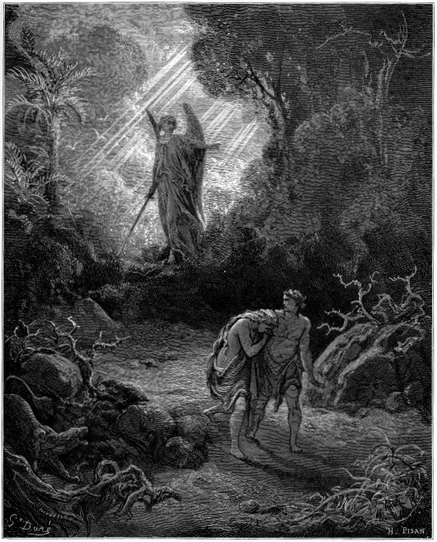
God’s Presence in the Old Testament

Slide 6
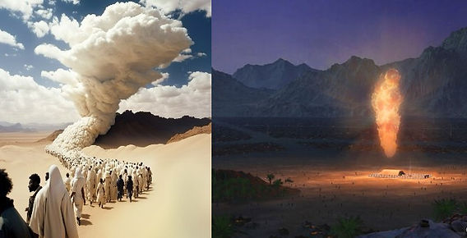
God’s Presence in the Old Testament

Slide 7
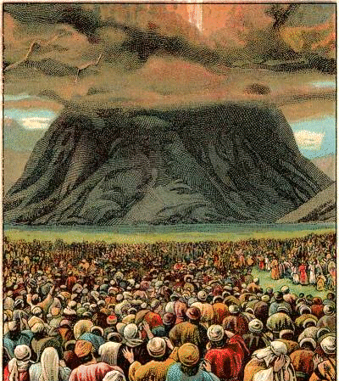
God’s Presence in the Old Testament

Slide 8
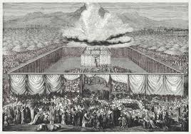
God’s Presence in the Old Testament

Slide 9
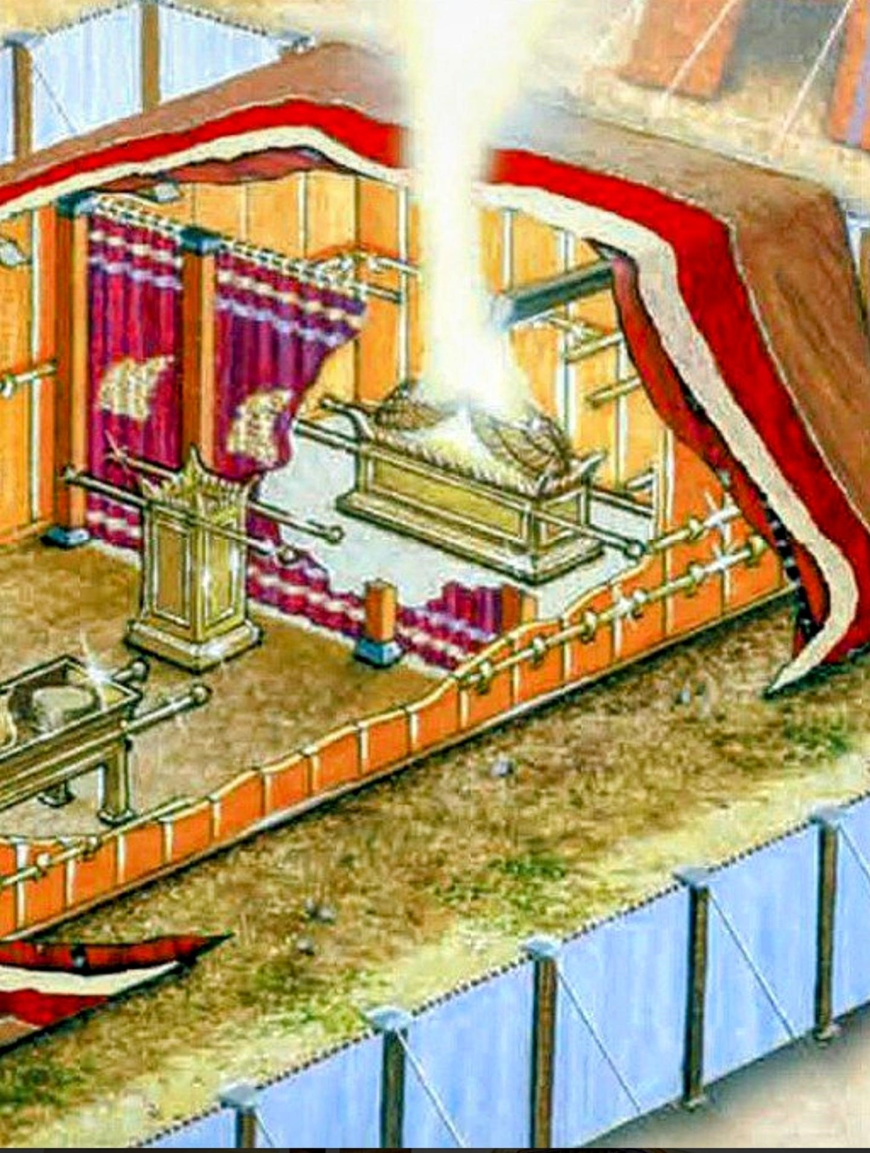
God’s Presence in the Old Testament

Slide 10
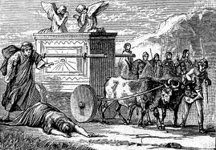
God’s Presence in the Old Testament

Slide 11
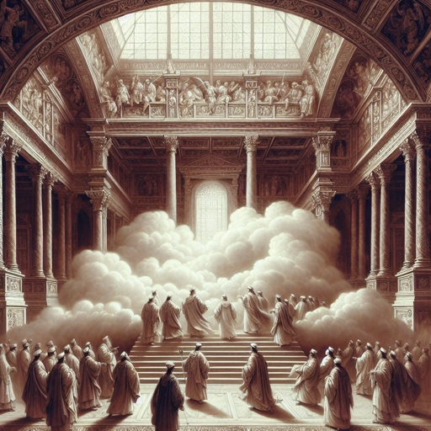
God’s Presence in the Old Testament

Slide 12
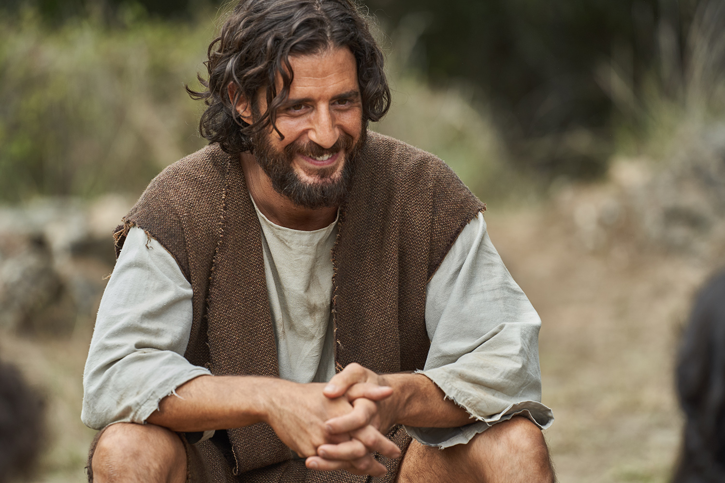
God’s Presence in the Old Testament

Slide 13
Heresies
Jesus isn’t God who looks like a human
Docetism – (gk) to appear

Slide 14
Heresies
Jesus isn’t God who looks like a human
Docetism – (gk) to appear
Jesus isn’t a man who is Godlike
Ebionitism – a mere man anointed by God

Slide 15
Heresies
Jesus isn’t God who looks like a human
Docetism – (gk) to appear
Jesus isn’t a man who is Godlike
Ebionitism – a mere man anointed by God
Jesus isn’t a divine but created being, lower than God but higher than humans
Arianism – belief of Arius

Slide 16
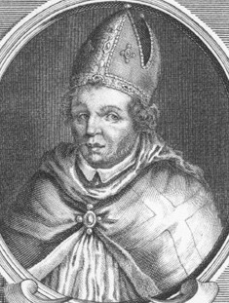
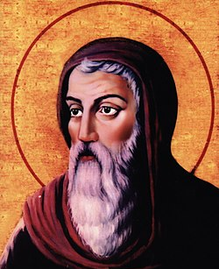
Heresies – Arius v Athanasius
Jesus was created by God
Higher than all creatures
But not equal with God
Jesus is same essence as God
Eternally begotten, not made
Equal with God

Slide 17
Nicene Creed, 325
We believe in one Lord, Jesus Christ, the only Son of God, eternally begotten of the Father, God from God, Light from Light, true God from true God, begotten, not made, of one being with the Father

Slide 18
Chalcedon, 451
Hypostatic Union – how God is 100% human and 100% God
Jesus Christ is ‘acknowledged in Two Natures unconfusedly, unchangeably, indivisibly, inseparably; the difference of the Natures being in no way removed because of the Union, but rather the properties of each Nature being preserved, and (both) concurring into One Person and One Hypostasis; not as though He was parted or divided into Two Persons, but One and the Self-same Son and Only-begotten God, Word, Lord, Jesus Christ.’

Slide 19
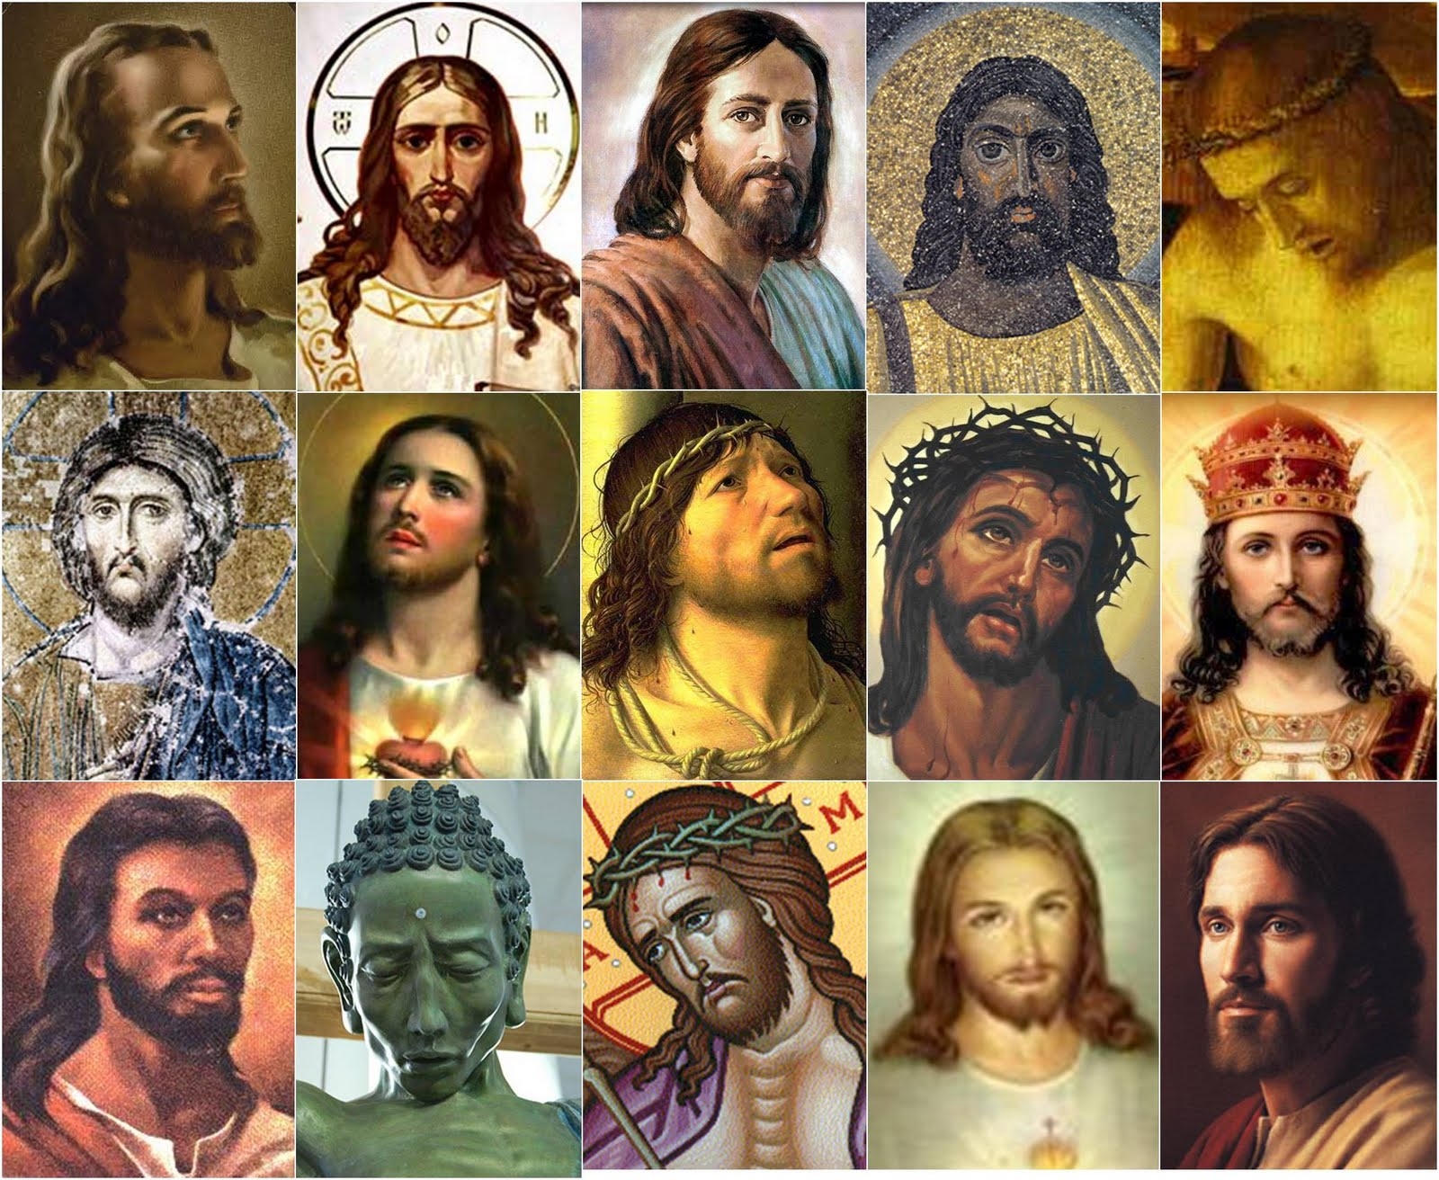

Slide 20
Why does the incarnation matter?
1.) God gets us

Slide 21
1.) God gets us
Hebrews 4:15 - “We do not have a high priest who is unable to empathise with our weaknesses, but one who has been tempted in every way, just as we are—yet he did not sin.”

Slide 22
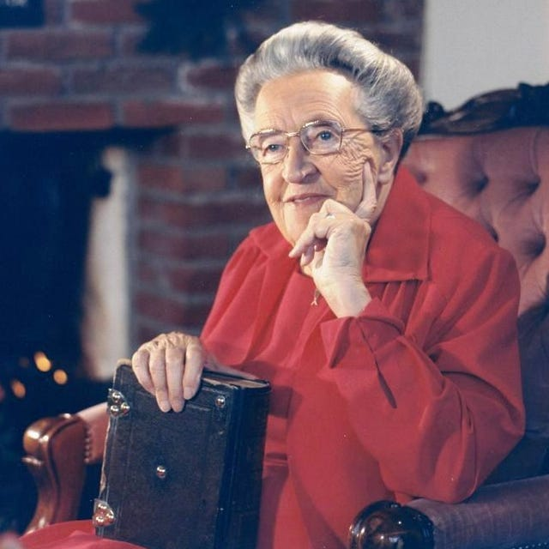
1.) God gets us
Hebrews 4:15 - “We do not have a high priest who is unable to empathise with our weaknesses, but one who has been tempted in every way, just as we are—yet he did not sin.”

Slide 23
Why does the incarnation matter?
1.) God gets us
2.) Only God could save us

Slide 24
2.) Only God could save us
Jesus had to be God in order to forgive sin, conquer death and give us eternal life

Slide 25
2.) Only God could save us
Jesus had to be God in order to forgive sin, conquer death and give us eternal life
Jesus had to be human to fully represent us and to take our place

Slide 26
2.) Only God could save us
Jesus had to be God in order to forgive sin, conquer death and give us eternal life
Jesus had to be human to fully represent us and to take our place
Gregory of Nazianus: ‘What has not been assumed, has not been healed’

Slide 27
Why does the incarnation matter?
1.) God gets us
2.) Only God could save us
3.) God came among us

Slide 28
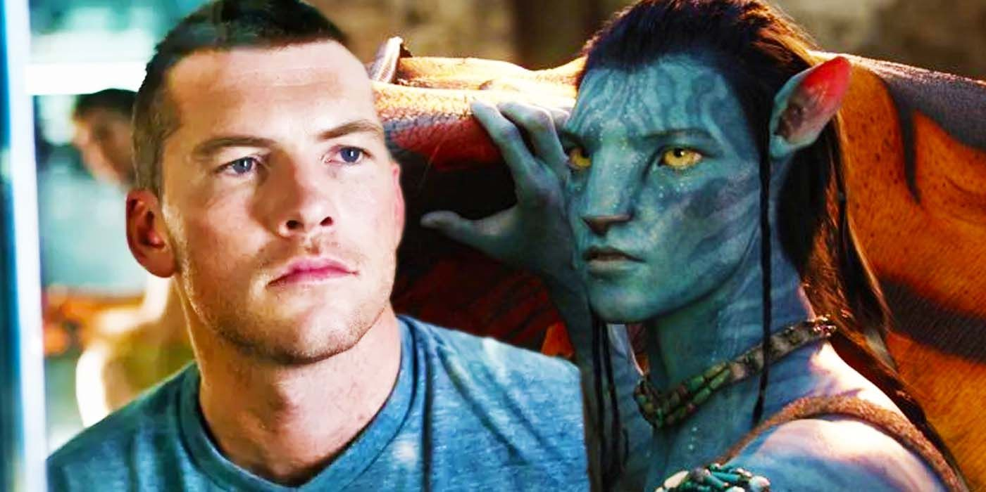
3.) God came among us

Slide 29
Why does the incarnation matter?
1.) God gets us
2.) Only God could save us
3.) God came among us
4.) Jesus shows us true humanity

Slide 30
Why does the incarnation matter?
1.) God gets us
2.) Only God could save us
3.) God came among us
4.) Jesus shows us true humanity
5.) God redeems the ordinary

Slide 31
Why does the incarnation matter?
1.) God gets us
2.) Only God could save Us
3.) God came among us
4.) Jesus shows us true humanity
5.) God redeems the ordinary
6.)The incarnation reclaims the body

