Slide 1

Coming Alive: Judges & Kings
Christie Gilfeather

Slide 2

Judges and Kings: Through these books we will look at the challenging stories of Israel’s struggles. What lessons can we learn today from this history?

Slide 3
The Hebrew Bible or ‘TaNaK’
Torah/Pentateuch
(law)
Nevi’im (prophets)
Ketuvim (writings)
Genesis
Exodus
Leviticus
Numbers
Deuteronomy
Joshua
Judges
1Samuel
2Samuel
1Kings
2Kings
Isaiah
Jeremiah
Ezechiel
Hosea
Joel
Amos
Obadiah
Jonah
Micah
Nahum
Habakkuk
Zephaniah
Haggai
Zechariah
Malachi
Psalms
Job
Proverbs
Ruth
Song of Songs
Ecclesiastes
Lamentations
Esther
Daniel
Ezra
Nehemiah
Chronicles
Notes:
This is the order they appear in in a Jewish Bible -- What do you notice?

Slide 4
The Hebrew Bible or ‘TaNaK’
Former Prophets
& Latter Prophets
Genesis
Exodus
Leviticus
Numbers
Deuteronomy
Joshua
Judges
1Samuel
2Samuel
1Kings
2Kings
Isaiah
Jeremiah
Ezechiel
Hosea
Joel
Amos
Obadiah
Jonah
Micah
Nahum
Habakkuk
Zephaniah
Haggai
Zechariah
Malachi
Psalms
Job
Proverbs
Ruth
Song of Songs
Ecclesiastes
Lamentations
Esther
Daniel
Ezra
Nehemiah
Chronicles
Notes:
This is the order they appear in in a Jewish Bible -- What do you notice?

Slide 5
The Former Prophets?
Why might the books of Judges and Kings be called the ‘former prophets’ in the Jewish tradition?
Joshua
Judges
1Samuel
2Samuel
1Kings
2Kings
Isaiah
Jeremiah
Ezekiel
Hosea
Joel
Amos
Obadiah
Jonah
Micah
Nahum
Habakkuk
Zephaniah
Haggai
Zechariah
Malachi

Slide 6
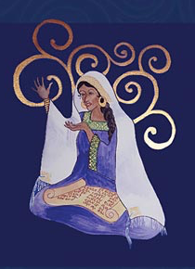
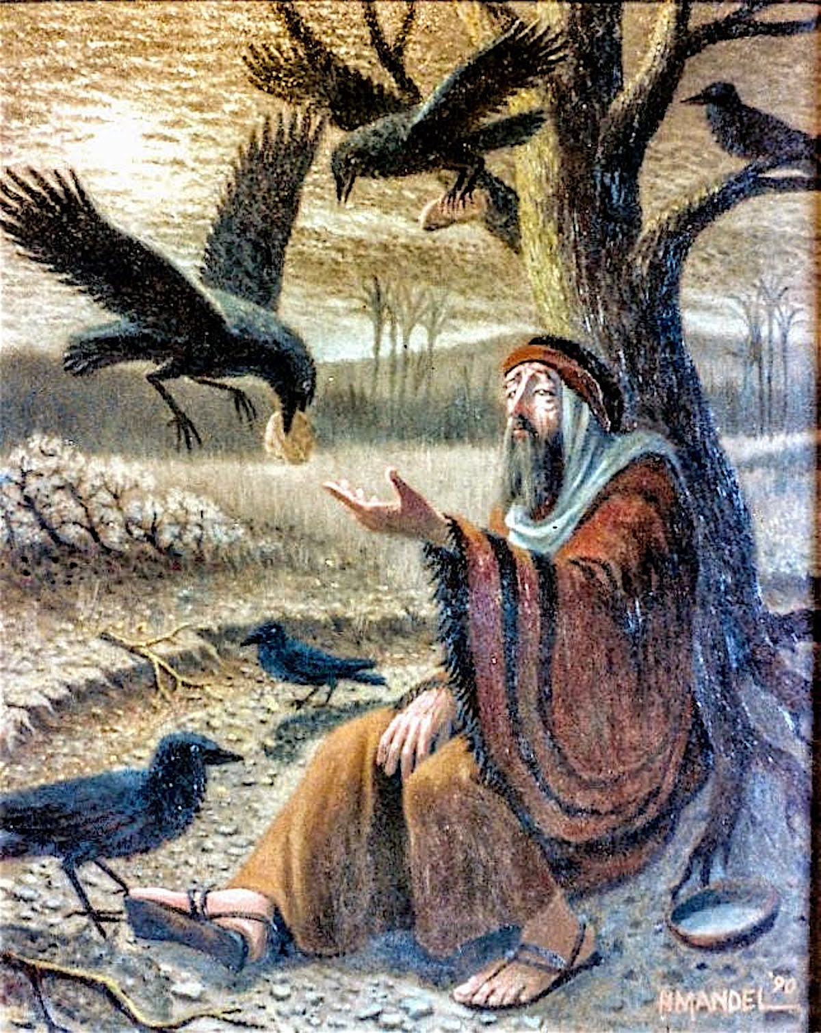
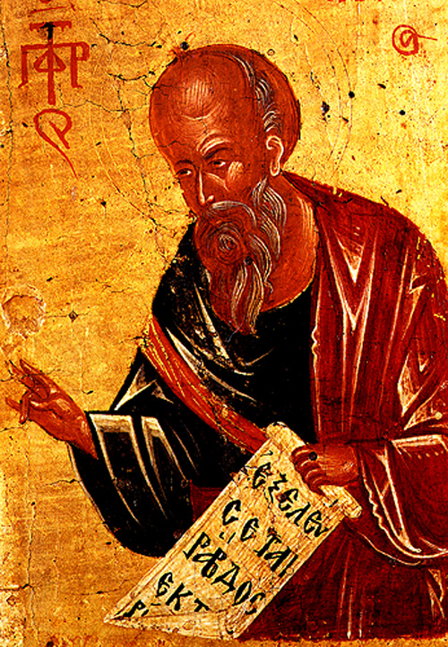
The Former Prophets?
Huldah: 2 Kings 22, Elijah: 1 Kings and Elisha: 1-2 Kings

Slide 7
Deuteronomistic History
Deuteronomy
Joshua
Judges
1Samuel
2Samuel
1Kings
2Kings

Slide 8
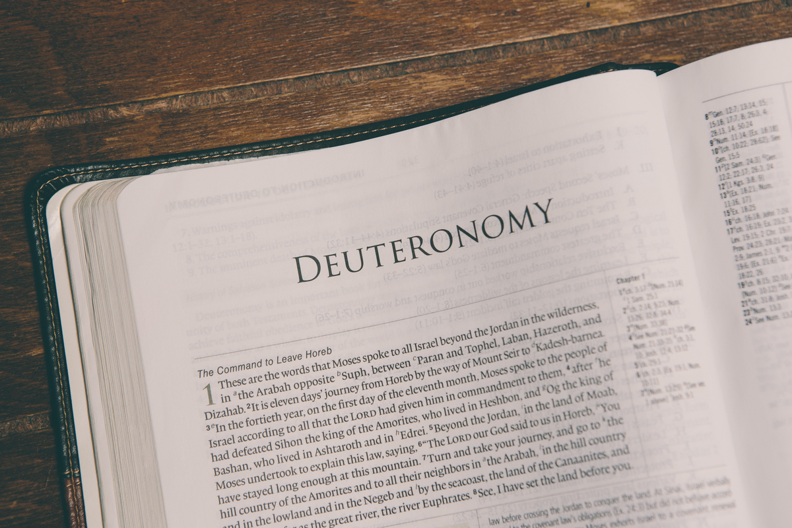
Deuteronomistic History
The book of Deuteronomy sets up the most important themes and issues which are then explored in the rest of the Deuteronomistic History.

Slide 9
Theological Themes
Covenant Theology
God’s covenant love (hesed)
Israel’s covenant
Sin and disobedience cycle and decline
Davidic Promise 2 Sam 7
The Land and a Place (Jerusalem)
What type of leader should we have?
What makes true worship?

Slide 10
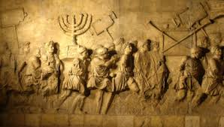
Theological Purpose
‘…to explain the overthrow of the nation as a justified divine punishment for the religious misdeeds of the people and their kings.’
Eg the exile (which you will cover next week)
Richard Nelson, The Historical Books, (Abingdon Press, 1998) p 68.

Slide 11
An ambiguous ending…
2Kings 25:27
In the thirty-seventh year of the exile of King Jehoiachin of Judah, in the twelfth month, on the twenty-seventh day of the month, King Evil-merodach of Babylon, in the year that he began to reign, released King Jehoiachin of Judah from prison; ²⁸ he spoke kindly to him, and gave him a seat above the other seats of the kings who were with him in Babylon. ²⁹
So Jehoiachin put aside his prison clothes. Every day of his life he dined regularly in the king’s presence. ³⁰ For his allowance, a regular allowance was given him by the king, a portion every day, as long as he lived.

Slide 12
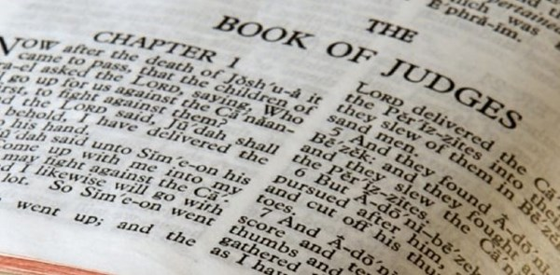
Judges
Notes:
Next we have the Judges:
Here you can see one of the most famous incidents in the book of Judges, the moment in Samson and Delilah’s relationship where she realies that his power lies in his hair – here she is poised with scissors in hand!
There are all sort of interesting and disturbing stories in this period.
Unfortunately, the period of the Judges is tumultuous! They aren't very good at leading the people, so the people demand a King
(1 sam 8)

Slide 13
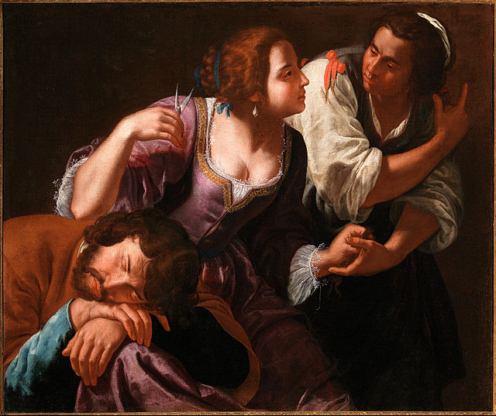
Judges
Joshua
Othniel
Ehud
Deborah
Gideon
Jepthah
Samson
Samuel
Gentileschi, Samson and Delilah, 1630-1638 public domain (commons.wikimedia)
Notes:
Next we have the Judges:
Here you can see one of the most famous incidents in the book of Judges, the moment in Samson and Delilah’s relationship where she realies that his power lies in his hair – here she is poised with scissors in hand!
There are all sort of interesting and disturbing stories in this period.
Unfortunately, the period of the Judges is tumultuous! They aren't very good at leading the people, so the people demand a King
(1 sam 8)

Slide 14
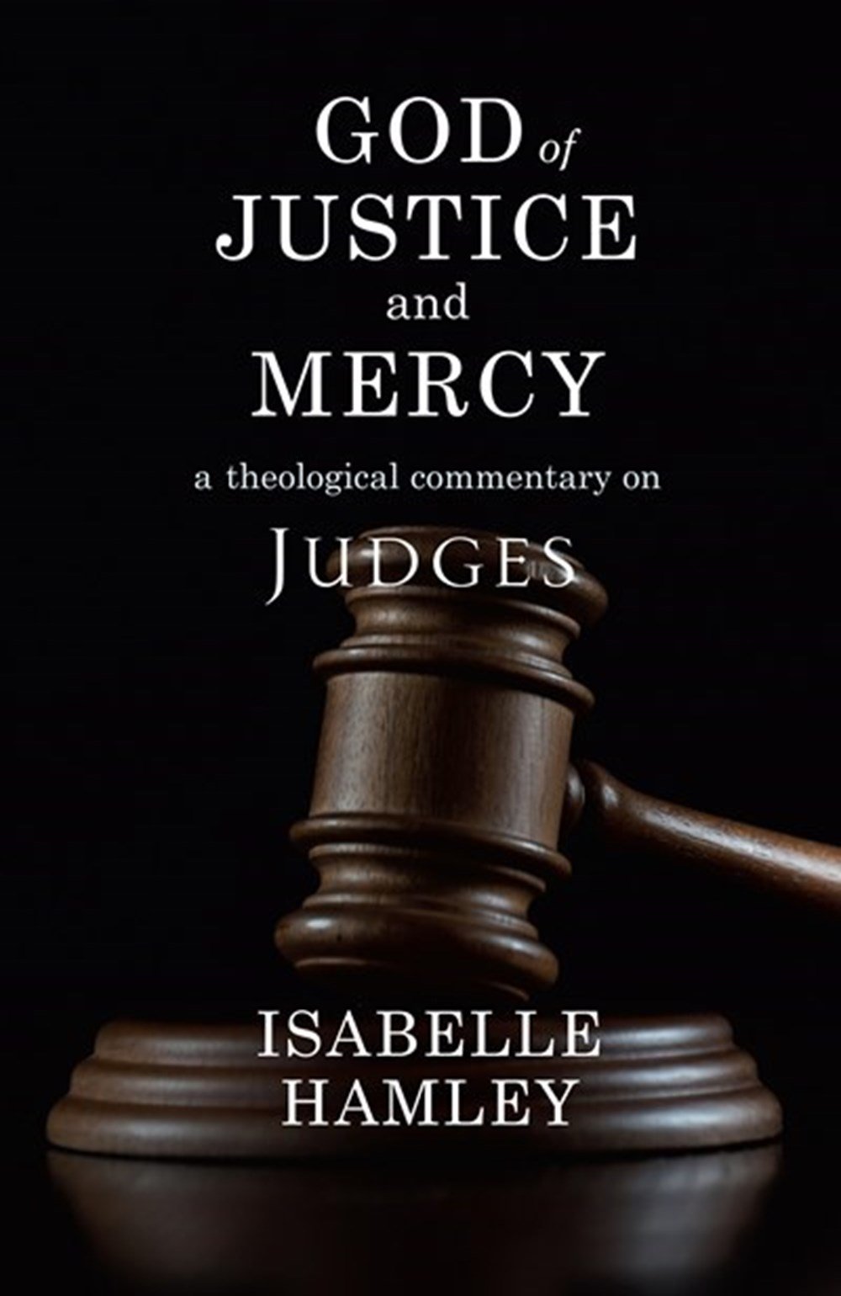
Judges
‘Heavily edited stories occasionally make their way into public worship, but overall, Judges has been spurned by worshippers and interpreters alike’
Isabelle Hamley, Judges (SCM:2021) p 1
Notes:
Next we have the Judges:
Here you can see one of the most famous incidents in the book of Judges, the moment in Samson and Delilah’s relationship where she realies that his power lies in his hair – here she is poised with scissors in hand!
There are all sort of interesting and disturbing stories in this period.
Unfortunately, the period of the Judges is tumultuous! They aren't very good at leading the people, so the people demand a King
(1 sam 8)

Slide 15
Judges
Yet ‘many thematic threads in Judges resonate with timeless questions: the difficulty of finding socio-political systems that enable the flourishing of all; corruption of local and national leadership; the problematic nature of political and military power; ethnic, land-based and socio-economic tensions; war and armed conflict; the inability of violence to achieve lasting peace; abuses of power in private and public settings…’
Isabelle Hamley, Judges (SCM:2021) p 1
Notes:
Next we have the Judges:
Here you can see one of the most famous incidents in the book of Judges, the moment in Samson and Delilah’s relationship where she realies that his power lies in his hair – here she is poised with scissors in hand!
There are all sort of interesting and disturbing stories in this period.
Unfortunately, the period of the Judges is tumultuous! They aren't very good at leading the people, so the people demand a King
(1 sam 8)

Slide 16
Judges: Between Conquest and Monarchy
By the middle of the book of Joshua, the promised land has (mostly) been conquered
In this period the people need leadership, and so God raises up Judges among them
But, each Judge either fails to lead well or dies
Notes:
Next we have the Judges:
Here you can see one of the most famous incidents in the book of Judges, the moment in Samson and Delilah’s relationship where she realies that his power lies in his hair – here she is poised with scissors in hand!
There are all sort of interesting and disturbing stories in this period.
Unfortunately, the period of the Judges is tumultuous! They aren't very good at leading the people, so the people demand a King
(1 sam 8)

Slide 17
Judges: Between Conquest and Monarchy
Judges 2:18-20
‘¹⁸ Whenever the Lord raised up judges for them, the Lord was with the judge, and he delivered them from the hand of their enemies all the days of the judge, for the Lord would be moved to pity by their groaning because of those who persecuted and oppressed them.
¹⁹ But whenever the judge died, they would relapse and behave worse than their ancestors, following other gods, serving them and bowing down to them. They would not drop any of their practices or their stubborn ways. ²⁰ So the anger of the Lord was kindled against Israel…’
Notes:
Next we have the Judges:
Here you can see one of the most famous incidents in the book of Judges, the moment in Samson and Delilah’s relationship where she realies that his power lies in his hair – here she is poised with scissors in hand!
There are all sort of interesting and disturbing stories in this period.
Unfortunately, the period of the Judges is tumultuous! They aren't very good at leading the people, so the people demand a King
(1 sam 8)

Slide 18
Monarchy in the Hebrew Bible

Slide 19
Build-a-king
What is the ideal king like?

Slide 20
Monarchy
1Sam. 8:4
Then all the elders of Israel gathered together and came to Samuel at Ramah, ⁵ and said to him, “You are old and your sons do not follow in your ways; appoint for us, then, a king to govern us, like other nations.” ⁶ But the thing displeased Samuel when they said, “Give us a king to govern us.”

Slide 21
Monarchy
1 Sam 8:6b-8
’Samuel prayed to the LORD, ⁷ and the LORD said to Samuel, “Listen to the voice of the people in all that they say to you; for they have not rejected you, but they have rejected me from being king over them. ⁸ Just as they have done to me, from the day I brought them up out of Egypt to this day, forsaking me and serving other gods, so also they are doing to you’

Slide 22
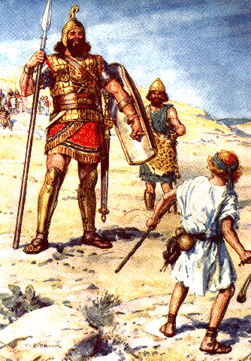
Why was the monarchy established?
Biblical Reasons
    Protection
    To be like Other Nations
    (1 Sam 8:4)
Sociological Reasons
    Superiority of Enemies
        Pressure on Land
        Leads to centralisation

Slide 23
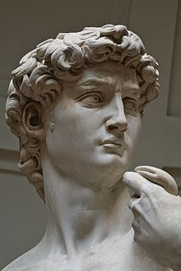
United Monarchy
Saul: ill fated(1 Sam 10:1)
David: man after God’s own heart (1 Sam 13:14)
Solomon: wise fool (1 Kings 11)
Traditionally dated to 1050 – 930BCE
Establishment of Jerusalem as the ‘City of David’: capital of Israel (2 Sam 5)
Establishment of the first Temple in Jerusalem (1 Kings 6)
Israel and Judah Divide (1 Kings 12)
Picture: detail of ‘David’ by Michaelangelo

Slide 24
Divided monarchy
Israel: North
Judah: South
Civil War (with Israel)
Uzziah / Azraiah: 2 Kings 15: Golden Age
Hezekiah / Josiah : 2 Kings 18-23 : Reforms
Battle of Carchemish 605BCE: becomes vassal state to Babylon
Jehoiakim’s self-surrender to Babylon (2 Kings 24:12)
The first Exile 597 BCE
1 Kings 12: Israel rebels against Rehoboam, leading to the division of the monarchy
Jeroboam becomes king of the Northern Kingdom
Dynasties subsequently rise and fall
722 bce : Assyrian invasion
2 Kings 15:29: first deportations to Assyria
Nb: Hosea is dated to this period

Slide 25
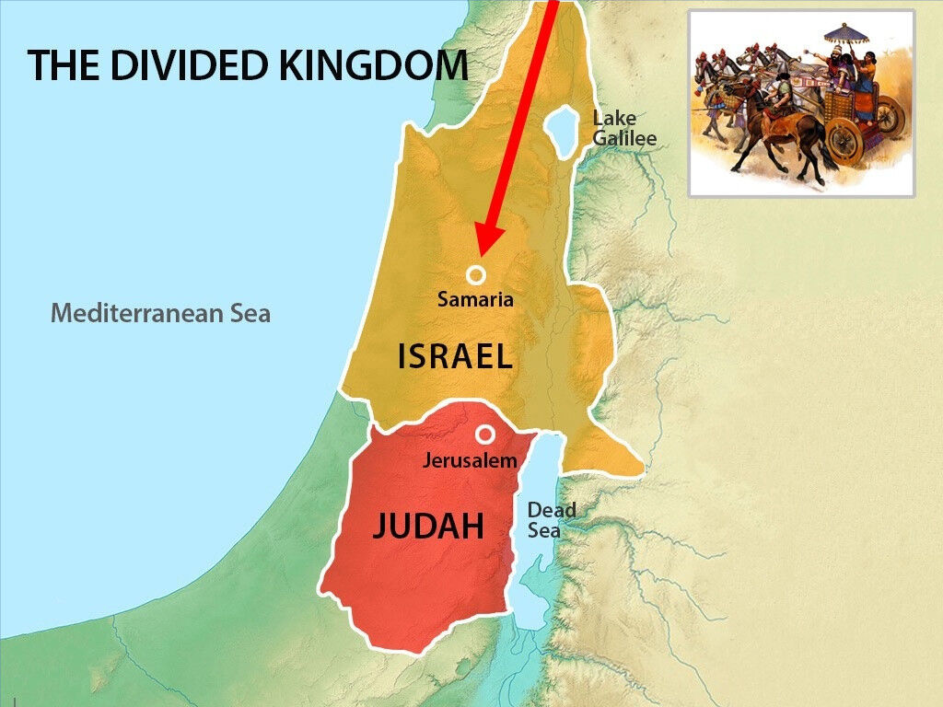

Slide 26
What are the Pros and cons of having a king?

Slide 27
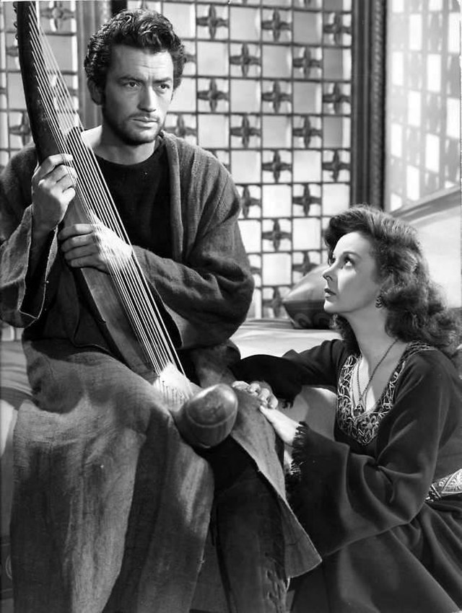
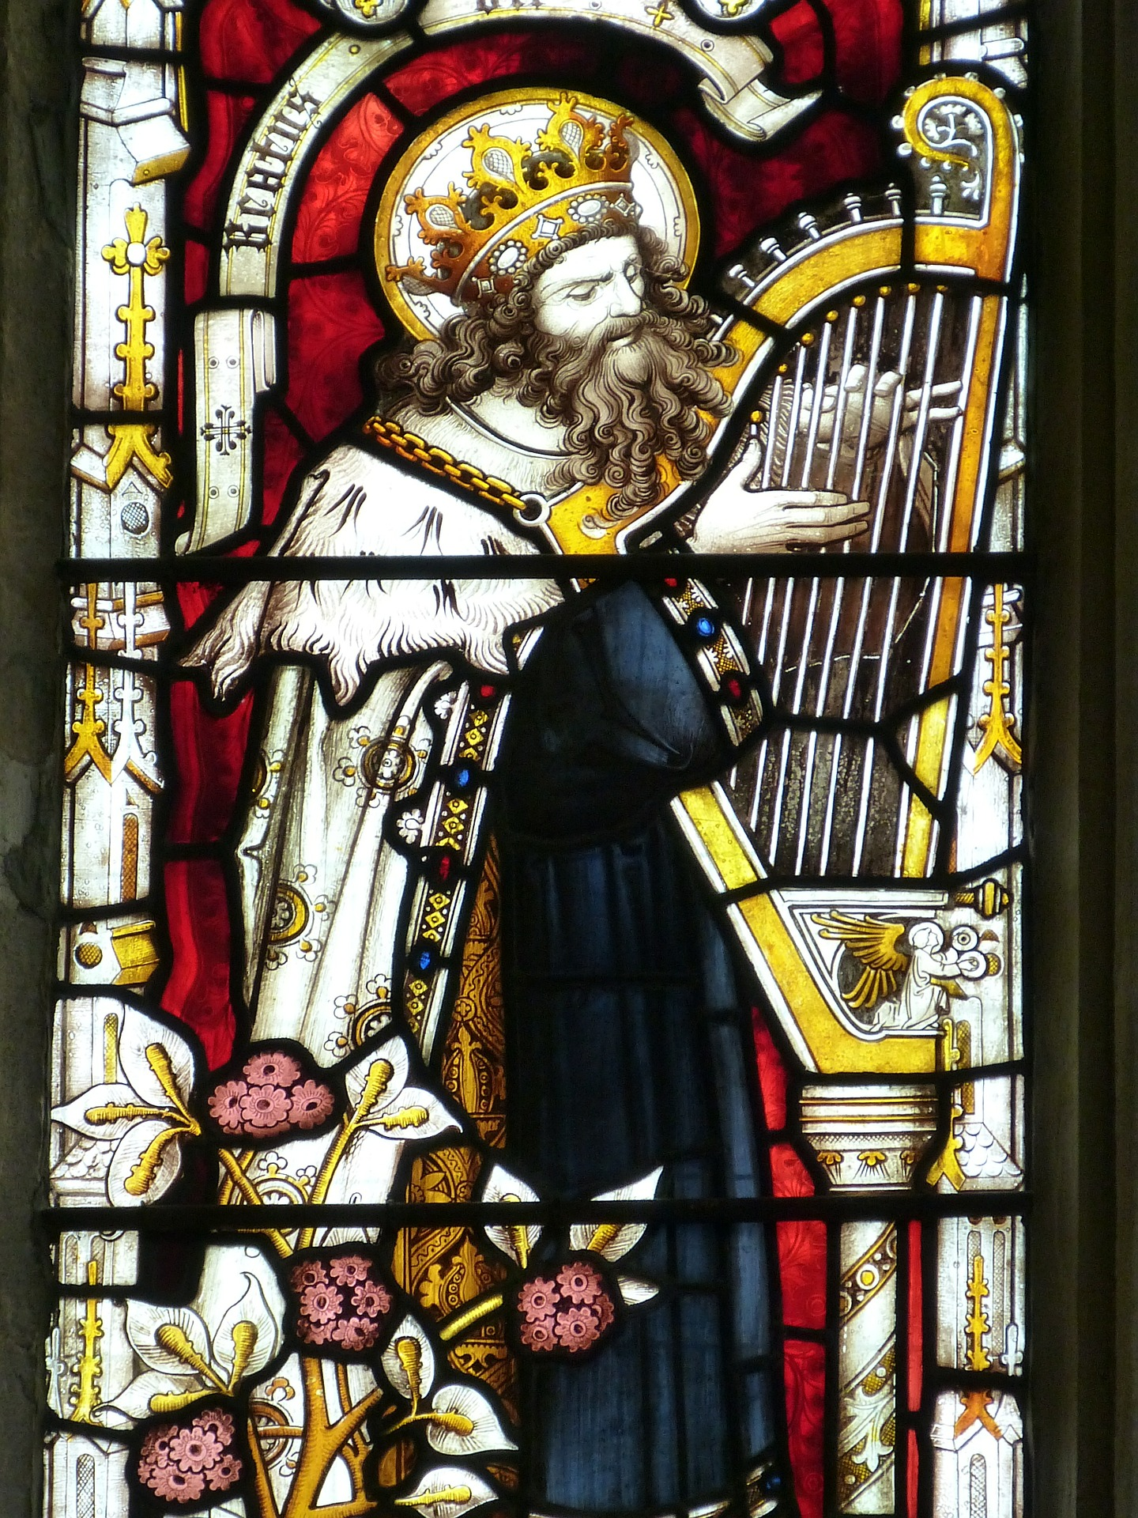
Case study: David

Slide 28
Case study: David
Pros:
Man after God’s own heart (1 Sam 13:14)
A Shepherd
‘Ruddy with beautiful eyes’ (1 Sam 16:12)
Worshipful (2 Sam 6)
Makes and keeps covenants (1 Sam 20)
2 Sam 9: ‘ David asked, “Is there anyone still left of the house of Saul to whom I can show kindness for Jonathan’s sake?’
Cons:
Adulterer (2 Sam 11)
Murderer (2 Sam 12)
Nathan: ‘You are the man!’ 2 Sam 12:7
Terrible sons 2 Sam 13-16
Ultimately shamed by Absalom (2 Sam 15)
Becomes politically ineffective (2 Sam 15-24)
Conducts an illegal census just before his death (2 Sam 24)

Slide 29
Trajectory
‘Israel's fate in the land hinged on the nation's obedience or disobedience to the law of Moses as set forth in the book of Deuteronomy’
- Nelson, ‘The Historical Books’, p 68
Josiah
Joshua
David
Solomon
Judges
Saul
kings
Manasseh

Slide 30
Yhwh as king
Psalm 146:9 The LORD watches over the strangers; he upholds the orphan and the widow, but the way of the wicked he brings to ruin.
Allen draws a parallel with Psa 68/82 where ‘the ideals of an ancient Near Eastern kingship are implicitly applied to Yahweh’¹
¹Allen, L. C., Psalms 101-50, (Nashville: Thomas Nelson, 2002), p 379

Slide 31
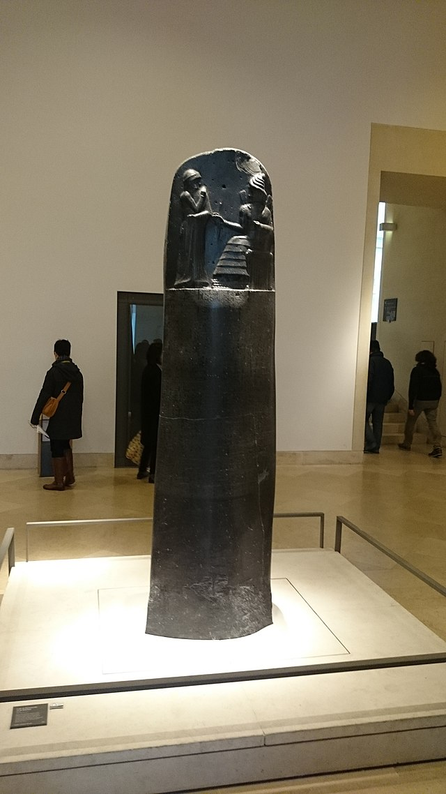
Yhwh as king
Hammurabi:
‘That the strong might not injure the weak, in order to protect the widows and orphans, I have in Babylon the city where Anu and Bel raise high their head, in E-Sagil, the Temple, whose foundations stand firm as heaven and earth, in order to bespeak justice in the land, to settle all disputes, and heal all injuries, set up these my precious words, written upon my memorial stone, before the image of me, as king of righteousness’

