Slide 1
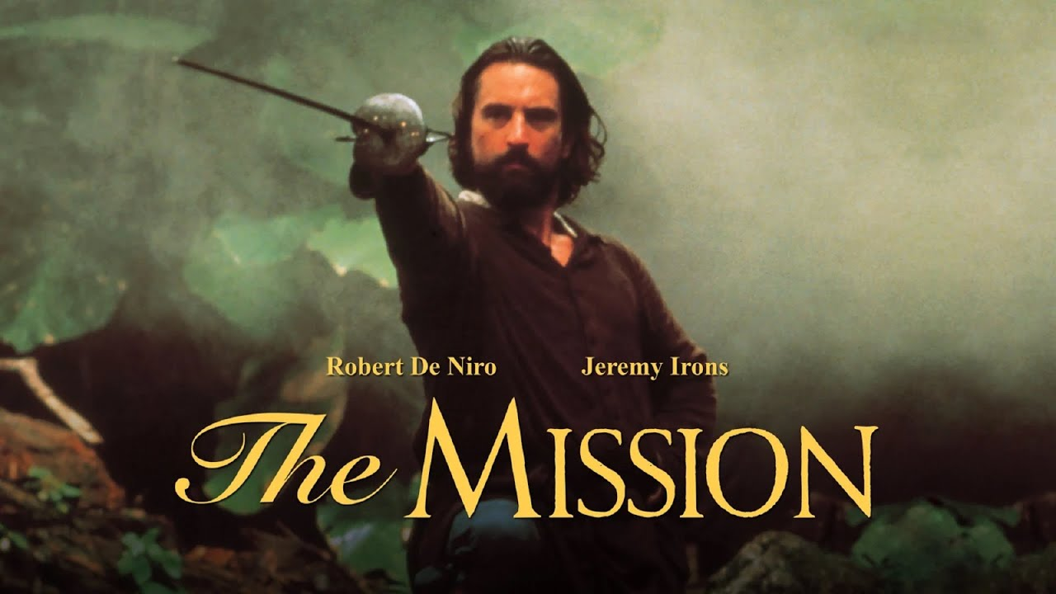
1: What is Mission?
3: The church as a community of missionary disciples
2: Reading the Bible with Missional lenses
Beginning Theology: Missiology

Slide 2
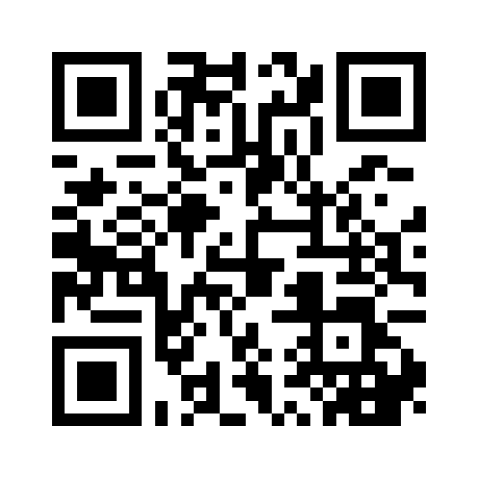
Menti.com
8581 2526
Word Cloud
Beginning Theology: Missiology
1: What is Mission?
2: Reading the Bible with Missional lenses
3: The church as a community of missionary disciples

Slide 3

3: The church as a community of missionary disciples
1: What is Mission?
2: Reading the Bible with Missional lenses
Mission stems from the Latin verb mitto (with missio being the noun form) and simply means ‘to send’.
It is also the linguistic origin of the term ‘Apostle’.
Mitto is a translation of the Greek verb apostello which occurs over 130 times in the New Testament and means ‘to send’ or ‘to send out’.
8581 2526
8581 2526
Menti.com
Word Cloud
Mission in a post-Christendom world

Slide 4
3: The church as a community of missionary disciples
1: What is Mission?
2: Reading the Bible with Missional lenses
‘Peace be with you. As the Father has sent me, so I send you’. When he had said this, he breathed on them and said to them, ‘Receive the Holy Spirit’. (John 20.20-21)
Mission in a post-Christendom world
Mission as sending
As you have sent me into the world so I have sent them into the world. (John 17.18)
Mission as sending
‘the one who sent me’ (Luke 9.48)
Mission as sending
‘remind you of all I have said to you’ (John 14.26)
Mission stems from the Latin verb mitto (with missio being the noun form) and simply means ‘to send’.
Mitto is a translation of the Greek verb apostello which occurs over 130 times in the New Testament and means ‘to send’ or ‘to send out’.
It is also the linguistic origin of the term ‘Apostle’.

Slide 5
3: The church as a community of missionary disciples
1: What is Mission?
2: Reading the Bible with Missional lenses
Guder & Barrett, Missional Church, a Vision for the Sending of the Church in North America. (Grand Rapids, Michigan: W.B.Eerdmans Pub, 1998) p. 6
Mission stems from the Latin verb mitto (with missio being the noun form) and simply means ‘to send’.
It is also the linguistic origin of the term ‘Apostle’.
Mitto is a translation of the Greek verb apostello which occurs over 130 times in the New Testament and means ‘to send’ or ‘to send out’.
Mission is not just a program of the church. It defines the church as God’s sent people. Either we are defined by mission, or we reduce the scope of the gospel and the mandate of the church. Thus our challenge today is to move from church with mission to missional church.
Mission as sending
‘the one who sent me’ (Luke 9.48)
‘remind you of all I have said to you’ (John 14.26)
As you have sent me into the world so I have sent them into the world. (John 17.18)
‘Peace be with you. As the Father has sent me, so I send you’. When he had said this, he breathed on them and said to them, ‘Receive the Holy Spirit’. (John 20.20-21)

Slide 6
3: The church as a community of missionary disciples
1: What is Mission?
2: Reading the Bible with Missional lenses
What is your mission and church experience
My church is missional and sees outreach as the calling of everyone
Some within my church are active in mission but not everyone
My church tries to reach out but with very limited results
My church isn’t outward looking and focuses on those within the church
The main mission activities my church engages in: (pick as many as apply)
Running an alpha (or similar course)
Social action (foodbank/homeless outreach)
Evangelistic Guest services
Collaborative projects in the community
Messy Church (or another fresh expression)
Personal evangelism
Caring for creation
Street Evangelism/door knocking/healing on streets
‘Peace be with you. As the Father has sent me, so I send you’. When he had said this, he breathed on them and said to them, ‘Receive the Holy Spirit’. (John 20.20-21)
Menti.com
8581 2526
Poll
Mission as sending
As you have sent me into the world so I have sent them into the world. (John 17.18)
‘the one who sent me’ (Luke 9.48)
Mission as sending
‘remind you of all I have said to you’ (John 14.26)
Mission is not just a program of the church. It defines the church as God’s sent people. Either we are defined by mission, or we reduce the scope of the gospel and the mandate of the church. Thus our challenge today is to move from church with mission to missional church.
Guder & Barrett, Missional Church, a Vision for the Sending of the Church in North America. (Grand Rapids, Michigan: W.B.Eerdmans Pub, 1998) p. 6

Slide 7



3: The church as a community of missionary disciples
2: Reading the Bible with Missional lenses
What is your mission and church experience
My church is missional and sees outreach as the calling of everyone
Some within my church are active in mission but not everyone
My church tries to reach out but with very limited results
My church isn’t outward looking and focuses on those within the church
The main mission activities my church engages in: (pick as many as apply)
Running an alpha (or similar course)
Social action (foodbank/homeless outreach)
Evangelistic Guest services
Collaborative projects in the community
Messy Church (or another fresh expression)
Personal evangelism
Caring for creation
Street Evangelism/door knocking/healing on streets
Wright, The Mission of God, Unlocking the Bible’s Grand Narrative (Oxford: IVP. 2006) p.22-3
Fundamentally our mission (if it is biblically informed and validated) means our committed participation as God’s people at God’s invitation and command, in God’s own mission within the history of the world for the redemption of God’s creation.
Poll
Menti.com
8581 2526
3 types of lenses:
Binoculars
Magnifying glass
3D glasses

Slide 8
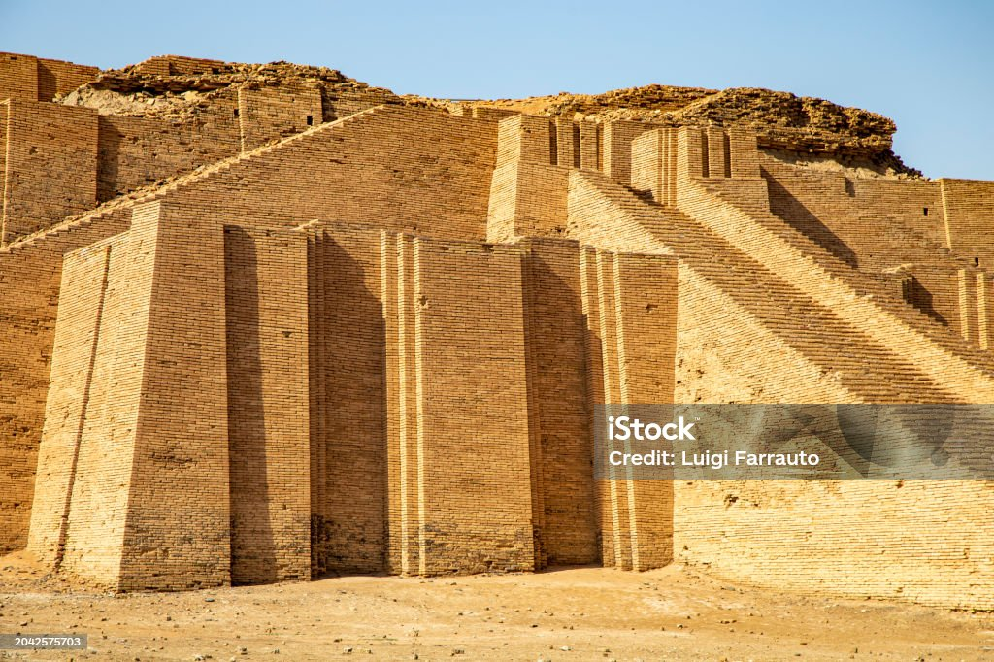
3: The church as a community of missionary disciples
2: Reading the Bible with Missional lenses
Binoculars
Magnifying glass
3D glasses
Abram – Abraham ‘ The Father of Many Nations’
3 types of lenses:
City Of Ur
Abram – Abraham ‘ The Father of Many Nations’#
Fundamentally our mission (if it is biblically informed and validated) means our committed participation as God’s people at God’s invitation and command, in God’s own mission within the history of the world for the redemption of God’s creation.
Wright, The Mission of God, Unlocking the Bible’s Grand Narrative (Oxford: IVP. 2006) p.22-3

Slide 9
3: The church as a community of missionary disciples
2: Reading the Bible with Missional lenses
The purpose of the call is to fashion an alternative community in creation gone awry, to embody in human history the power of the blessing. It is the hope of God that in this new family all human history can be brought to the unity and harmony intended by the one who calls.
Wright, The Mission of God, Unlocking the Bible’s Grand Narrative (Oxford: IVP. 2006) p.22-3
Fundamentally our mission (if it is biblically informed and validated) means our committed participation as God’s people at God’s invitation and command, in God’s own mission within the history of the world for the redemption of God’s creation.
Brueggemann, Walter, Genesis: Interpretation: A Bible Commentary for Teaching and Preaching Genesis, (John Knox Press, 1982), p.105
Abram – Abraham ‘ The Father of Many Nations’
City Of Ur

Slide 10
3: The church as a community of missionary disciples
2: Reading the Bible with Missional lenses
I will make you into a great nation,
and I will bless you;
I will make your name great,
and you will be a blessing.^{[a]}
³ I will bless those who bless you,
and whoever curses you I will curse;
and all peoples on earth
will be blessed through you.
Abram – Abraham ‘ The Father of Many Nations’
City Of Ur
Abram – Abraham ‘ The Father of Many Nations’#
The purpose of the call is to fashion an alternative community in creation gone awry, to embody in human history the power of the blessing. It is the hope of God that in this new family all human history can be brought to the unity and harmony intended by the one who calls.
Brueggemann, Walter, Genesis: Interpretation: A Bible Commentary for Teaching and Preaching Genesis, (John Knox Press, 1982), p.105

Slide 11
3: The church as a community of missionary disciples
2: Reading the Bible with Missional lenses
The purpose of the call is to fashion an alternative community in creation gone awry, to embody in human history the power of the blessing. It is the hope of God that in this new family all human history can be brought to the unity and harmony intended by the one who calls.
Missio Dei (meaning the Mission of God)
Karl Barth - 1950s Brandenburg conference
Stephen Holmes – intrinsic to the character of God
John Flett – God’s eternal decision to be for humanity
a) Mission begins and ends with God
Brueggemann, Walter, Genesis: Interpretation: A Bible Commentary for Teaching and Preaching Genesis, (John Knox Press, 1982), p.105
I will make you into a great nation,
and I will bless you;
I will make your name great,
and you will be a blessing.^{[a]}
³ I will bless those who bless you,
and whoever curses you I will curse;
and all peoples on earth
will be blessed through you.

Slide 12
3: The church as a community of missionary disciples
2: Reading the Bible with Missional lenses
I will make you into a great nation,
and I will bless you;
I will make your name great,
and you will be a blessing.^{[a]}
³ I will bless those who bless you,
and whoever curses you I will curse;
and all peoples on earth
will be blessed through you.
b) Mission involves the particular and the universal​
Chris Wright says we need to start seeing the concept of election as a ’doctrine of mission’ and not ‘a calculus for the arithmetic of salvation’
Abrahamic blessing of ‘all nations’ (Genesis 12.3, 18.8, 22.18, 26.4 and 28.14)
a) Mission begins and ends with God
Missio Dei (meaning the Mission of God)
Karl Barth - 1950s Brandenburg conference
Stephen Holmes – intrinsic to the character of God
John Flett – God’s eternal decision to be for humanity

Slide 13
3: The church as a community of missionary disciples
2: Reading the Bible with Missional lenses
c) Mission is about blessing as well as saving
and all peoples on earth
will be blessed through you (Gen 12:3)
What is the goal of mission?
Missio Dei (meaning the Mission of God)
Karl Barth - 1950s Brandenburg conference
Stephen Holmes – intrinsic to the character of God
John Flett – God’s eternal decision to be for humanity
a) Mission begins and ends with God
b) Mission involves the particular and the universal​
Chris Wright says we need to start seeing the concept of election as a ’doctrine of mission’ and not ‘a calculus for the arithmetic of salvation’
Abrahamic blessing of ‘all nations’ (Genesis 12.3, 18.8, 22.18, 26.4 and 28.14)

Slide 14
3: The church as a community of missionary disciples
2: Reading the Bible with Missional lenses
c) Mission is about blessing as well as saving
and all peoples on earth
will be blessed through you (Gen 12:3)
What is the goal of mission?
Missio Dei (meaning the Mission of God)
Karl Barth - 1950s Brandenburg conference
Stephen Holmes – intrinsic to the character of God
John Flett – God’s eternal decision to be for humanity
a) Mission begins and ends with God
c) Mission involves Blessing as well as saving
The Mission of God is to redeem the whole of creation, broken by sin and evil, into the new creation, populated by the redeemed from every culture, through the cross and resurrection of Christ.
Wright, Chris. Integral Mission and The Great Commission: The Five Marks of Mission

Slide 15
3: The church as a community of missionary disciples
A community of Representation
The business of the church is to tell and embody a story, the story of God’s mighty acts in creation and redemption and of God’s promises concerning what will be in the end. The church affirms the truth of this story by celebrating it, interpreting it, and enacting it in the life of the contemporary world. It has no other way of affirming its truth . . . The church’s affirmation is that the story that it tells, embodies and enacts is the true story and that others are to be evaluated by reference to it.
Newbigin, Proper confidence: Faith, Doubt and Certainty in Christian Discpleship (Grand Rapids, MI: Wm.B.Erdmans Publishing Co, 1995) p.76
1 Thessalonians – A community of virtue
a kind of participation in God that means participation in the world in a radically new way. Thus faith, love and hope have to do with the distinctive form of Christian participation in the world; they are not merely centripetal activities but centrifugal ones. In other words they have to do with witness, with mission.
Gorman, Becoming the Gospel, p.65
c Mission involves Community
Thessalonians – A community of virtue Backstory – Acts 17
We always give thanks to God for all of you and mention you in our prayers, constantly remembering before our God and Father your work of faith and labour of love and steadfastness of hope in our Lord Jesus Christ.
(1 Thessalonians 1.2-3)

Slide 16
3: The church as a community of missionary disciples
1 Thessalonians – A community of virtue
Backstory – Acts 17
We always give thanks to God for all of you and mention you in our prayers, constantly remembering before our God and Father your work of faith and labour of love and steadfastness of hope in our Lord Jesus Christ.
(1 Thessalonians 1.2-3)
1 Thessalonians – A community of virtue
I am, of course, not denying the importance of the many activities by which we seek to challenge public life with the gospel – evangelistic campaigns, distribution of Bibles and Christian literature, conferences, and even books such as this one. But I am saying that these are all secondary, and that they have power to accomplish their purpose only as they are rooted in and lead back to a believing community.”
Lesslie Newbigin, The Gospel in a Pluralist Society (Grand Rapids, MI: Eerdmans, 1989), 227.
1 Thessalonians – A community of virtue
a kind of participation in God that means participation in the world in a radically new way. Thus faith, love and hope have to do with the distinctive form of Christian participation in the world; they are not merely centripetal activities but centrifugal ones. In other words they have to do with witness, with mission.
Gorman, Becoming the Gospel, p.65

Slide 17
Closing Thoughts
3: The church as a community of missionary disciples
1 Thessalonians – A community of virtue
a kind of participation in God that means participation in the world in a radically new way. Thus faith, love and hope have to do with the distinctive form of Christian participation in the world; they are not merely centripetal activities but centrifugal ones. In other words they have to do with witness, with mission.
Gorman, Becoming the Gospel, p.65
Beginning Theology: Missiology
1 Thessalonians – A community of virtue
I am, of course, not denying the importance of the many activities by which we seek to challenge public life with the gospel – evangelistic campaigns, distribution of Bibles and Christian literature, conferences, and even books such as this one. But I am saying that these are all secondary, and that they have power to accomplish their purpose only as they are rooted in and lead back to a believing community.”
Lesslie Newbigin, The Gospel in a Pluralist Society (Grand Rapids, MI: Eerdmans, 1989), 227.

Slide 18
Beginning Theology: Missiology
1 Thessalonians – A community of virtue
I am, of course, not denying the importance of the many activities by which we seek to challenge public life with the gospel – evangelistic campaigns, distribution of Bibles and Christian literature, conferences, and even books such as this one. But I am saying that these are all secondary, and that they have power to accomplish their purpose only as they are rooted in and lead back to a believing community.”
Lesslie Newbigin, The Gospel in a Pluralist Society (Grand Rapids, MI: Eerdmans, 1989), 227.
Closing Thoughts
We always give thanks to God for all of you and mention you in our prayers, constantly remembering before our God and Father your work of faith and labour of love and steadfastness of hope in our Lord Jesus Christ.
(1 Thessalonians 1.2-3)

