Slide 1

Where am I headed?
Marcus Throup

Slide 2
(1) Finding route… listening out for the Lord
DISCERNMENT
VOCATION
= Working out where I am headed…
= Working out what God is calling me to be and do…

Slide 3
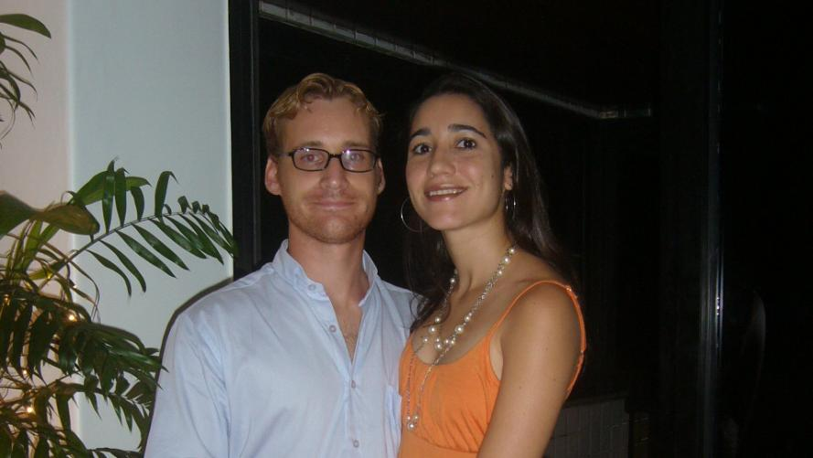

Slide 4
Listening out for the Lord: listening skills
Listen to your heart (but remember – it can be deceptive!);
(2) Listen to Scripture – God speaks through his Word;
(3)Listen to wise/trusted friends (but those who will be honest with you!);

Slide 5
Finding route… listening out for the Lord
Q. What are those milestones or turning points in your own life, when in one way or another God guided you in a particular direction?

Slide 6

(2) Recentre… staying true to ourselves, staying true to God

Slide 7

Stuff that takes us down the wrong path…

Slide 8
(2) Recentre… staying true to ourselves and staying true to God
Q. Are there areas in my life where I need to re-centre so as to stay true to myself and to God – where might I be going off track?

Slide 9
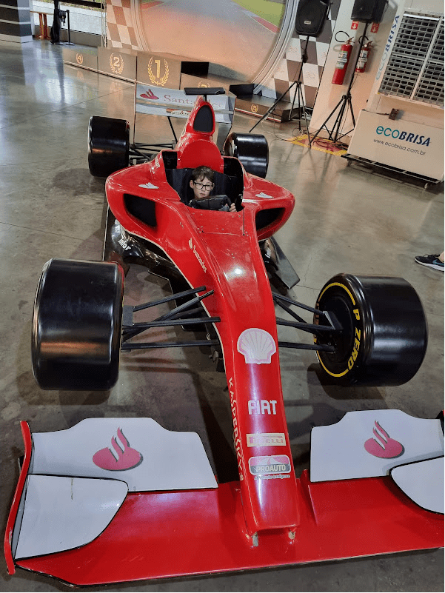
(3) Get fuel! Preparing for the journey ahead

