Slide 1

Who’s in Charge?
David Emerton

Slide 2
Who’s in charge?
“Jesus is Lord and everything else is $#**@£$*!”

Slide 3
Jesus is Lord
The kingdom of God
“I must proclaim the good news of the kingdom of God … because that is why I was sent.” (Luke 4:43)
“Jesus went into Galilee, proclaiming the good news of God. ‘The time has come,’ he said. ‘The kingdom of God has come near.’” (Mark 1:14–15)
The continued ‘exile’ of the people of God
“Where is Israel’s Messiah, God’s chosen king?”

Slide 4
Jesus is Lord
“Jews longed for the day when they would not be ruled by the Roman emperor or even by the pseudo-royal house of Herod, but would have God alone for their sovereign. The phrase ‘kingdom of God’ ... denoted, not a place where God ruled, but rather the fact that God ruled—or, rather, that he soon would rule, because he certainly was not doing so at present in the way he intended to do. Other lords had usurped his unique role as the sovereign of Israel.”

Slide 5
Jesus is Lord
The kingdom of God = a time when Israel’s God would become king
Emphatically present (inaugurated) in Jesus Christ
In the life of Jesus
In the death of Jesus
= the deathblow to sin, evil, and death
In the resurrection of Jesus
= the promise of salvation, of “a new heaven and a new earth” (Revelation 21:1)

Slide 6
Jesus is Lord

Slide 7
Jesus is Lord
“I believe like a child that suffering will be healed and made up for, that all the humiliating absurdity of human contradictions will vanish like a pitiful mirage … that in the world’s finale, at the moment of eternal harmony, something so precious will come to pass that it will suffice for all hearts, for the comforting of all resentments, for the atonement of all the crimes of humanity, of all the blood they’ve shed.”

Slide 8
Jesus is Lord
The kingdom of God = a time when Israel’s God would become king
Emphatically present (inaugurated) in Jesus Christ
In the life of Jesus
In the death of Jesus
In the resurrection of Jesus
Awaiting its final completion (consummation) in Jesus Christ
In the coming again of Jesus

Slide 9
Jesus is Lord

Slide 10
Jesus is Lord
A truth that affects everyone and everything!
A truth that changes reality!

Slide 11
Jesus is Lord
A truth that affects everyone and everything!
A truth that changes reality!
Is the kingdom of God an attractive truth for the church and the world? Why? Or why not?

Slide 12
Dietrich Bonhoeffer
A status confessionis—a ‘state’ or ‘stance of confession’
Jesus Christ alone is Lord!
“The time is fulfilled for the German people of Hitler. … Hitler is the way of the Spirit and the will of God for the German people to enter the Church of Christ.”
“The church is the space in the world in which, and until the end of the world, God’s word is again and again spoken, pronounced, delivered, expounded, and spread.”
The Confessing Church
The Barmen ‘Theological Declaration’ (1934)

Slide 13
Dietrich Bonhoeffer
“In view of the errors of the German Christians of the present Reich Church … which are devastating the Church and also therefore breaking up the unity of the German Evangelical Church, we confess the following evangelical truths: … Jesus Christ, as he attested for us in Holy Scripture, is the one Word of God which we have to hear and which we have to trust and obey in life and in death. We reject the false doctrine, as though the church could and would have to acknowledge as a source of its proclamation, apart from, and besides this one Word of God, still other events and powers, figures and truths, as God’s revelation.”

Slide 14
Dietrich Bonhoeffer
“In view of the errors of the German Christians of the present Reich Church … which are devastating the Church and also therefore breaking up the unity of the German Evangelical Church, we confess the following evangelical truths: … Jesus Christ, as he attested for us in Holy Scripture, is the one Word of God which we have to hear and which we have to trust and obey in life and in death. We reject the false doctrine, as though the church could and would have to acknowledge as a source of its proclamation, apart from, and besides this one Word of God, still other events and powers, figures and truths, as God’s revelation.”
A ‘no!’ to compromise with, or accommodation to, the political, financial, cultural, moral, and social powers of the day.

Slide 15
Dietrich Bonhoeffer
“Costly grace”
“forces people under the yoke of following Jesus Christ”
“costs people their lives”
“enables us to live”
“costs God the life of God’s Son”

Slide 16
Dietrich Bonhoeffer
“Costly grace”
“forces people under the yoke of following Jesus Christ”
“costs people their lives”
“enables us to live”
“costs God the life of God’s Son”
“Cheap grace”
“forgiveness without repentance”
“baptism without the discipline of community”
“the Lord’s Supper without confession of sin”
“absolution without personal confession”
“grace without discipleship, grace without the cross, grace without the living, incarnate Jesus Christ.”

Slide 17
Dietrich Bonhoeffer
“We are not to simply bandage the wounds of victims beneath the wheels of injustice, we are to drive a spoke into the wheel itself.”

Slide 18
Dietrich Bonhoeffer
“We are not to simply bandage the wounds of victims beneath the wheels of injustice, we are to drive a spoke into the wheel itself.”
“If that’s the case, then I shall reform it!” (Bonhoeffer, aged 14, speaking about the church to his family)

Slide 19
Dietrich Bonhoeffer
“We are not to simply bandage the wounds of victims beneath the wheels of injustice, we are to drive a spoke into the wheel itself.”
“If that’s the case, then I shall reform it!” (Bonhoeffer, aged 14, speaking about the church to his family)

Slide 20
Dietrich Bonhoeffer
1939, sailing across the Atlantic
“Great programmes simply lead us to where we are; but we ought to be found only where God is. … Or have I, after all, avoided the place where God is? The place where God is for me?”
“Since yesterday evening I haven’t been able to stop thinking about Germany. … I have made a mistake in coming to America. I must live through this difficult period of our national history with the Christian people of Germany.”

Slide 21
Dietrich Bonhoeffer
Public speaking and publishing ban

Slide 22
Dietrich Bonhoeffer
Public speaking and publishing ban
Joining the Abwehr and the resistance
“Operation 7”
Conspiring to overthrow and assassinate Hitler

Slide 23
Dietrich Bonhoeffer
Public speaking and publishing ban
Joining the Abwehr and the resistance
“Operation 7”
Conspiring to overthrow and assassinate Hitler

Slide 24
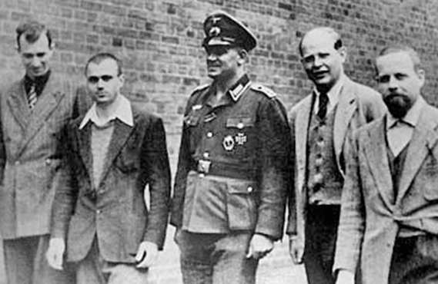
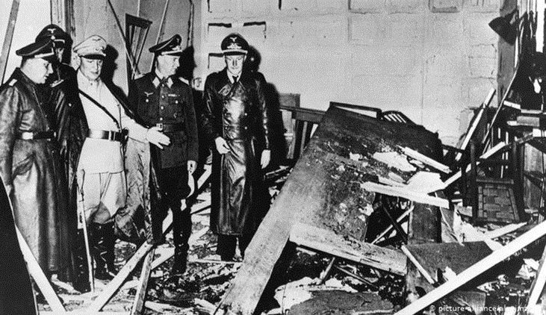
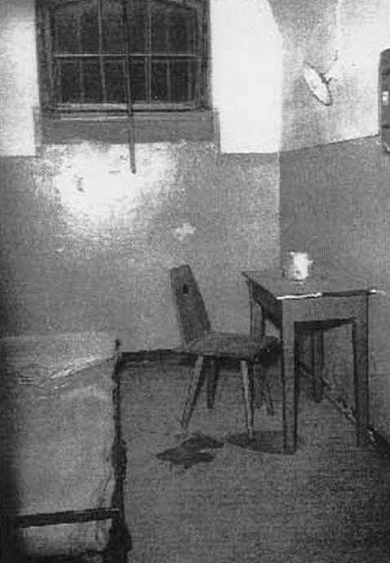
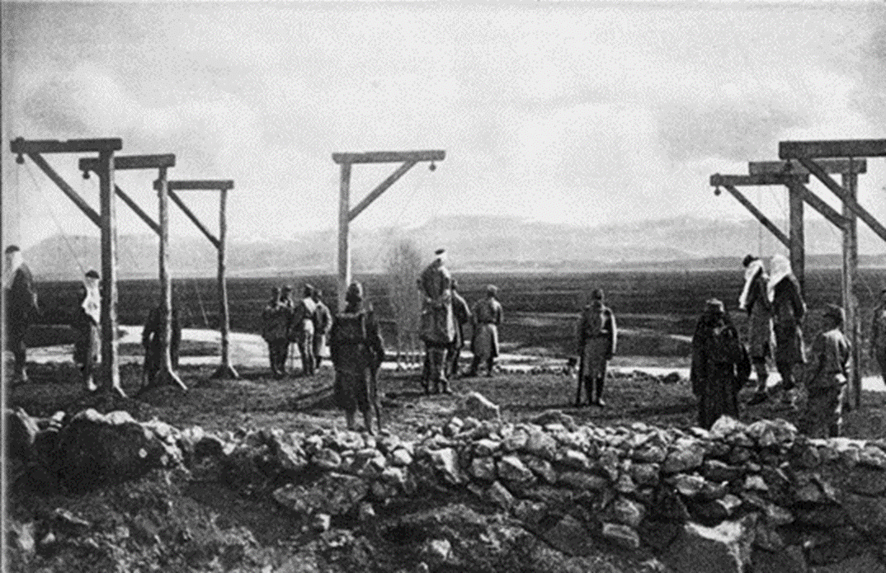
Dietrich Bonhoeffer
Public speaking and publishing ban
Joining the Abwehr and the resistance
“Operation 7”
Conspiring to overthrow and assassinate Hitler
“This is the end, for me the beginning of life.”

Slide 25
Dietrich Bonhoeffer
“On the morning of that day between five and six o’clock the prisoners … were taken from their cells, and the verdicts of the court martial read out to them. Through the half-open door in one room of the huts I saw Pastor Bonhoeffer, before taking off his prison garb, kneeling on the floor praying fervently to his God. I was most deeply moved by the way this loveable man prayed, so devout and so certain that God heard his prayer. At the place of execution, he again said a short prayer and then climbed the steps to the gallows, brave and composed. His death ensued after a few seconds. In the almost fifty years that I worked as a doctor, I have hardly ever seen a man die so entirely submissive to the will of God.”

Slide 26
So what?
Summoned to confess the truth that Jesus is Lord over everyone and everything
The pernicious ideologies of 21st century ‘isms’
The rejection of ‘would-be kings’

Slide 27
So what?
To confess the truth that Jesus is Lord with words
“For, ‘Everyone who calls on the name of the Lord will be saved’” … but as he goes on to ask … “How, then, can they call on the one they have not believed in? And how can they believe in the one of whom they have not heard? And how can they hear without someone preaching to them? And how can anyone preach unless they are sent? As it is written: ‘How beautiful are the feet of those who bring good news!’” (Romans 10: 14–16).
The good news of God’s gospel invites and requires a decision to follow Jesus, or not.
It is a summons to a change of beliefs, allegiance, loyalties, and lifestyle.

Slide 28
So what?
“The greatest proof of Christianity … is not how far a person can logically analyse their reasons for believing, but how far in practice they will stake their life on their beliefs.”

Slide 29
So what?
“A declaration may be bold and clear, and centrally Christian … but so long as it remains theoretical, entailing no obligation or venture on the part of the person who makes it, it is not confession and must not be mistaken for it.”

Slide 30
So what?
To confess the truth that Jesus is Lord in action
Enacting or performing the truth of Christ’s lordship

Slide 31
So what?
“Every act of love, gratitude and kindness; every work of art or music inspired by the love of God and delight in the beauty of his creation; every minute spent teaching a severely handicapped child to read or walk; every act of care and nurture, of comfort and support for one’s fellow human being’s, and for that matter one’s fellow non-human creatures; and of course every prayer; all Spirit-led teaching, every deed which spreads the gospel, builds up the church, embraces and embodies holiness rather than corruption, and makes the name of Jesus honoured in the world—all of this will find its way through the resurrecting power of God, into the new creation which God will one day make.”

Slide 32
So what?
Enacting or performing the truth that Jesus is Lord in our own unique way

Slide 33
So what?
“What could the call to follow Jesus mean today for the worker, the businessman [or woman], the farmer, or the soldier?” … “Could it bring an intolerable dilemma into the existence of persons working in the world who are Christian? … Where will the call to discipleship lead those who follow it? What decisions and painful separations will it entail? We must take this question to him who alone knows the answer. Only Jesus Christ, who bids us follow him, knows where the path will lead. But we know that it will be a path full of mercy beyond measure.”

