Slide 1

The Final Word: Reading Revelation
Revd Dr James Harding

Slide 2
Aims
How to understand the book of Revelation
When will it all happen?

Slide 3
Discussion Time
How do you feel about reading the book of Revelation?
Do you ignore it… or are you obsessed by it?
Is it a dangerous book?
Is your response Fight… or Flight?

Slide 4
Part 1: Six clues for reading
¹ The ¹revelation of Jesus Christ, which God gave him to show his servants what must soon take place; ²he made it known by sending his angel to his servant John, ² who testified to the word of God and to the testimony of Jesus Christ, even to all that he saw. ³ Blessed is the one who reads aloud the words of the prophecy, and ³blessed are those who hear and who ⁴keep what is written in it; for the time is near.

Slide 5
Part 1: Six hermeneutical clues
¹revelation = apokalupsis = revelatio
= remove a veil
= to unveil
= to reveal
= no longer hidden

Slide 6
Part 1: Six hermeneutical clues
²he made it known = esēmanen
= signify with symbols and signs
= metaphors and pictures
= “like”

Slide 7
Part 1: Six hermeneutical clues
³blessed = makarios
= happy
= not worried
= defined in the Beatitudes cf. Mt 5

Slide 8
Part 1: Six hermeneutical clues
⁴keep = tērēo
= obey the commandments
prophecy
= instructive NOT predictive

Slide 9
Discussion Time

Slide 10
Part 2: When does it all happen?
Preterist = Past = Alcazar c.1600
Futurist = Future = Ribera c.1590
Historicist = Ongoing = Left Behind 1995
Idealist = Spiritual = Tyconius c.380AD

Slide 11
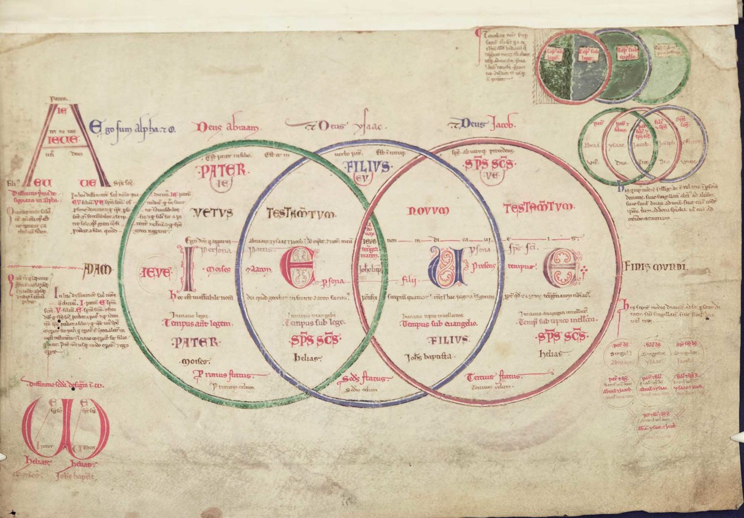
Part 2: When does it all happen?
Recapitulatory
Joachim of Fiore, Liber Figurarum c. 1199

Slide 12
Part 2: When does it all happen?
Prophecy = Three Cycles:
Historical cf. Dt 13:1-5
Christocentric cf. Mt 22:40; Lk 24:44
Eschatological cf. Acts 2:14

Slide 13
Part 2: When does it all happen?
OF Jesus Christ =
Rev. 1:8; 1:11 “the Alpha and the Omega … beginning and end… who is and who was and who is to come”
Rev. 1:17 “the first and the last”

Slide 14
Discussion Time

Slide 15
The Final Word: Reading Revelation
Revd Dr James Harding

