Slide 1

Coming Alive: Matthew
Jonny Rowlands

Slide 2
Today’s Session
Introduction to Matthew’s Gospel
Key themes
Christology in Matthew

Slide 3
1. Introduction to Matthew’s Gospel

Slide 4
A. What is a Gospel?
If I told you a new Gospel had just been discovered, what would you expect to be in it?

Slide 5
A. What is a Gospel?
Genre = the particular category of literature a text is
Genre creates expectations (to be fulfilled or subverted)
E.g., “Knock, knock …”
What genre are the Gospels?

Slide 6
A. What is a Gospel?
‘Gospel’ only used 4x by Matt.; 8x by Mark; (2x in Acts)
(‘To evangelise’ used 10x in Luke)
“The beginning of the Gospel [τοῦ εὐαγγελίου] of Jesus Christ [Son of God].” Mark 1.1.
A ‘euangelion’ in Graeco-Roman culture was an announcement about the Emperor

Slide 7
A. What is a Gospel?
“Since Providence, which has ordered all things and is deeply interested in our life, has set in most perfect order by giving us Augustus, whom she filled with virtue that he might benefit humankind, sending him as a saviour, both for us and for our descendants, that he might end war and arrange all things, and since he, Caesar, by his appearance excelled even our anticipations, surpassing all previous benefactors, and not even leaving to posterity any hope of surpassing what he has done, and since the birthday of the god Augustus was the beginning of the good news for the world that came by reason of him, which Asia resolved in Smyrna.”
The Priene Calendar Inscription.

Slide 8
B. Matthew and the Synoptics
‘Synoptic’ = ‘seeing together’ / ‘seen together’
The Synoptic Gospels = Matthew, Mark and Luke
John is very different in tone and content

Slide 9
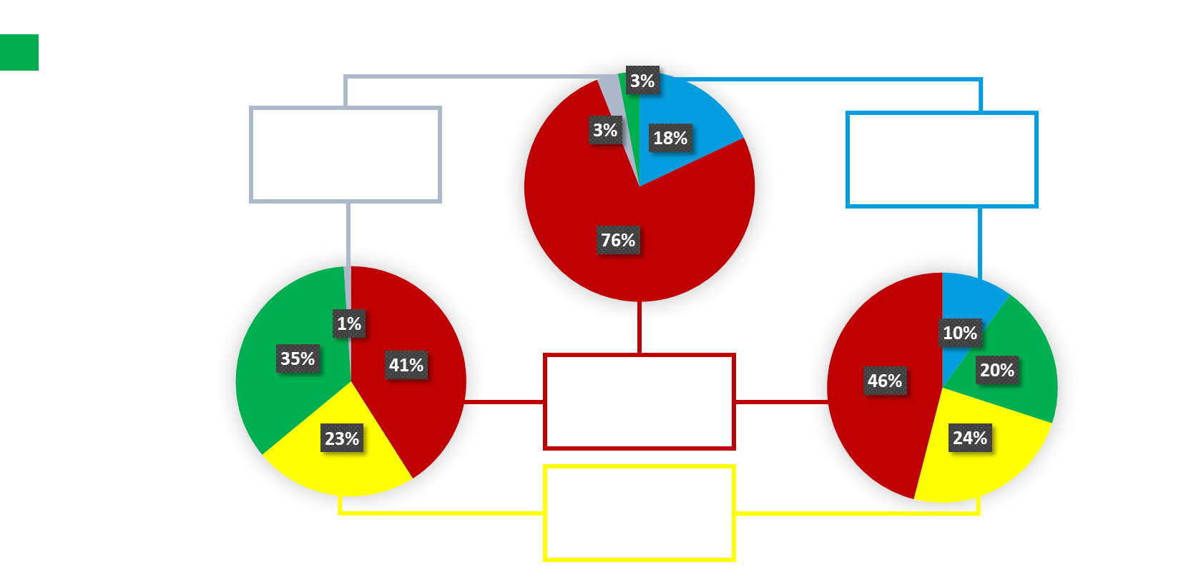
B. Matthew and the Synoptics

Slide 10

B. Matthew and the Synoptics

Slide 11

B. Matthew and the Synoptics

Slide 12
B. Matthew and the Synoptics
Your ‘solution’ to the synoptic problem determines what changes might writers makes to his source(s)
Changes often imply intent
Matt’s use of Mark = universally assumed
Matt’s use of Luke (and vice versa) = debated

Slide 13
Questions?

Slide 14
2. Key Themes

Slide 15
A. Jesus and the Gentiles
“These twelve Jesus sent out with the following instructions: ‘Do not take a road leading to gentiles, and do not enter a Samaritan town, but go rather to the lost sheep of the house of Israel.’” (10.5-6)
“I was sent only to the lost sheep of the house of Israel.” (15.24)
“All authority in heaven and on earth has been given to me. Go therefore and make disciples of all nations.” (28.18-19)

Slide 16
A. Jesus and the Gentiles
Jesus finds a lack of faith & obedience within Israel
Jesus finds that faith & obedience in unexpected gentiles
Roman centurion (8.5-13)
A Canaanite (cf. Mark: Syro-Phoenician) woman (15.21-28)

Slide 17
A. Jesus and the Gentiles
Ongoing narrative in Matthew of expansion of who is part of the covenant people of Israel
Israel is now expanded beyond ethnic boundaries by the end of Matt.
Foreshadowed by Rahab in Matt. 1.5 (cf. Josh. 2)
This does not mean Israel has been ‘replaced’

Slide 18
B. Jesus and Jewish Law
Jesus consistently acts in accordance with Jewish law through Matt. (& the other Gospels!)
“Do not think that I have come to abolish the Law or the Prophets; I have come not to abolish but to fulfill. For truly I tell you, until heaven and earth pass away, not one letter, not one stroke of a letter, will pass from the law until all is accomplished.” (5.17-18)
E.g., debates over (im)purity; ‘cleansing’ of Leproi

Slide 19
C. The Kingdom of Heaven
Matt. never mentions ‘the Kingdom of God’
Instead, he prefers ‘the Kingdom of Heaven’
Avoiding the name of God?
Dual-level narrative (Jonathan Pennington)?

Slide 20
Questions?

Slide 21
3. Christology in Matthew

Slide 22
A. Jesus as Davidic King
David = ideal (if complicated) messianic king figure in Israel’s history
Widespread expectation of a coming Davidic Messiah-King in 2nd Temple Judaism
Matthew presents Jesus as this Davidic Messiah-King

Slide 23
A. Jesus as Davidic King
Gematria = assigning numbers to letters
E.g., “I love the woman whose number is 545.”
David = 14 (דוד = D-4; V-6; D-4)
“So all the generations from Abraham to David are fourteen generations; and from David to the deportation to Babylon, fourteen generations; and from the deportation to Babylon to the Messiah, fourteen generations” (1.17). I.e., Jesus = David³.

Slide 24
B. Jesus as Emmanuel
“All this took place to fulfill what had been spoken by the Lord through the prophet: ‘Look, the virgin shall become pregnant and give birth to a son, and they shall name him Emmanuel,’ which means, ‘God is with us.’” (1.22-23)
“And remember, I am with you always, to the end of the age.” (28.20)
Emmanuel is a Matthean inclusio

Slide 25
C. Jesus as God
Walking on water (14.22-33): “and those in the boat worshiped him.”
Caligula and the Floating Bridge of Baiae
“Seemed fitting to him as a god.”

Slide 26
C. Jesus as God
Jesus the mother hen: “How often have I desired to gather your children together as a hen gathers her brood under her wings, and you were not willing!” (Matt. 23.37-38)
“Guard me as the apple of the eye hide me in the shadow of your wings from the wicked who despoil me, my deadly enemies who surround me.” (Psalm 18.8-9)
“May the Lord reward you for your deeds, and may you have a full reward from the Lord, the God of Israel, under whose wings you have come for refuge!” (Ruth 2.12)

Slide 27
Questions?

