Slide 1

Biographies of Jesus
Jessica Norman

Slide 2
Overview
Why do we have four Gospels?
This session will give you an overview of the four Gospels in the New Testament … exploring their similarities and differences and how each offers a distinctive view of Jesus.
  Deepen our understanding
  Reflect together
Gospels reveal Jesus

Slide 3

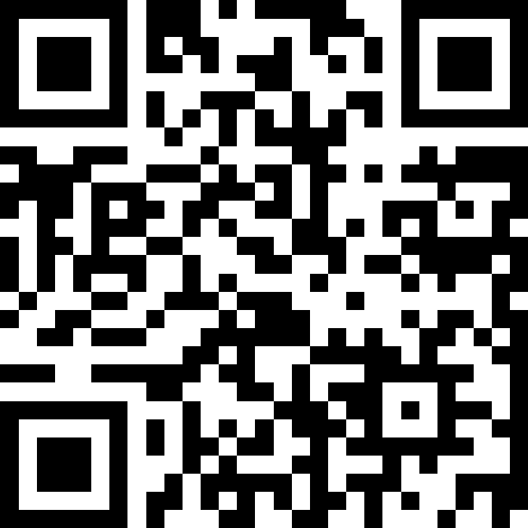
Got questions?

Slide 4
What are the Gospels?
Good News
  Εὐαγγελίου - euangelion ”Good News”
  Mark 1:1 “The beginning of the good news about Jesus the Messiah, the Son of God.”
Eyewitness Accounts
  Testimonies
Biographies
  Genre, closest to a Greco-Roman biography
    Style
    Word-count
    Focus

Slide 5
Models
Diamond 💎
Images:
  Matthew: Person 🧑
  Mark: Lion 🦁
  Luke: Ox 🐂
  John: Eagle 🦅
CS Lewis
  Liar 🥸
  Lunatic 🤪
  Lord ✝️

Slide 6
Synoptics
Mark
Matthew, Mark, Luke
John
Two source Hypothesis
Q
Matthew
Luke

Slide 7
Synoptics & John
Synoptics | John
John the Baptist’s ministry Jesus’ baptism The temptation of Jesus The healing of Peter’s mother-in-law The healing of a paralyzed man The call of Matthew/Levi The healing of a man with a withered hand The parable of the Sower and its interpretation The feeding of the five thousand Peter’s confession The first prediction of the passion The transfiguration The healing of an epileptic boy Jesus’ encounter with the rich, young ruler The triumphal entry into Jerusalem The cleansing of the temple The prediction of the temple’s destruction The “eschatological” discourse The preparation for the Passover The Lord’s Supper Jesus’ prayer in Gethsemane The arrest of Jesus Peter’s denial of Jesus Jesus’ appearance before Pilate | John the Baptist’s ministry Jesus’ baptism The temptation of Jesus The healing of Peter’s mother-in-law The healing of a paralyzed man The call of Matthew/Levi The healing of a man with a withered hand The parable of the Sower and its interpretation The feeding of the five thousand Peter’s confession The first prediction of the passion The transfiguration The healing of an epileptic boy Jesus’ encounter with the rich, young ruler The triumphal entry into Jerusalem The cleansing of the temple The prediction of the temple’s destruction The “eschatological” discourse The preparation for the Passover The Lord’s Supper Jesus’ prayer in Gethsemane The arrest of Jesus Peter’s denial of Jesus Jesus’ appearance before Pilate

Slide 8
Synoptics & John
Synoptics | John | Unique to John
John the Baptist’s ministry Jesus’ baptism The temptation of Jesus The healing of Peter’s mother-in-law The healing of a paralyzed man The call of Matthew/Levi The healing of a man with a withered hand The parable of the Sower and its interpretation The feeding of the five thousand Peter’s confession The first prediction of the passion The transfiguration The healing of an epileptic boy Jesus’ encounter with the rich, young ruler The triumphal entry into Jerusalem The cleansing of the temple The prediction of the temple’s destruction The “eschatological” discourse The preparation for the Passover The Lord’s Supper Jesus’ prayer in Gethsemane The arrest of Jesus Peter’s denial of Jesus Jesus’ appearance before Pilate | John the Baptist’s ministry Jesus’ baptism The temptation of Jesus The healing of Peter’s mother-in-law The healing of a paralyzed man The call of Matthew/Levi The healing of a man with a withered hand The parable of the Sower and its interpretation The feeding of the five thousand Peter’s confession The first prediction of the passion The transfiguration The healing of an epileptic boy Jesus’ encounter with the rich, young ruler The triumphal entry into Jerusalem The cleansing of the temple The prediction of the temple’s destruction The “eschatological” discourse The preparation for the Passover The Lord’s Supper Jesus’ prayer in Gethsemane The arrest of Jesus Peter’s denial of Jesus Jesus’ appearance before Pilate | Jesus washing the disciples feet The miracle of changing water into wine (2:1–11) The conversation with Nicodemus (3:1–21) The meeting with the Samaritan woman (4:1–42) The healing of a lame man at the pool of Bethesda (5:1–15) The healing of the man born blind (chap. 9) The raising of Lazarus (11:1–44) Jesus’ washing the disciples’ feet (13:1–17) The Farewell Discourses (chaps. 14–16) The high-priestly prayer (chap. 17) Jesus’ special resurrection appearance to Mary Magdalene (20:11–18) Jesus’ appearance to Thomas (20:24–29)

Slide 9
Discussion break:
How would you summarise the gospel in one sentence?
Why are the Gospels to be seen as good news?

Slide 10
Exploring the Gospels
Basics
Ideas
Overview

Slide 11
Exploring the Gospels
Basics:
  📝Writer
  ⛰️Setting
  👫Audience
Ideas:
  💬main verse summary
  ⬆️Purpose
  👀Things to look out for
  🔑Key to understanding
Overview:
  📖Arc of the story
  🔥Application

Slide 12
Matthew
Basics:
  📝Writer: Matthew, known as Levi
  ⛰️Setting: 80CE (approx.)
  👫Audience: Jewish audience
Ideas:
  💬main verse summary: Matthew 22:36-38
  ⬆️Purpose: see, Jesus is the promised Son of God, Jesus is Lord
  👀Things to look out for: Names, Kingdom
  🔑Key to understanding: Jesus fulfils the law and Prophets
Overview:
  📖Arc of the story: 5 main teaching blocks
  🔥Application: the big picture

Slide 13
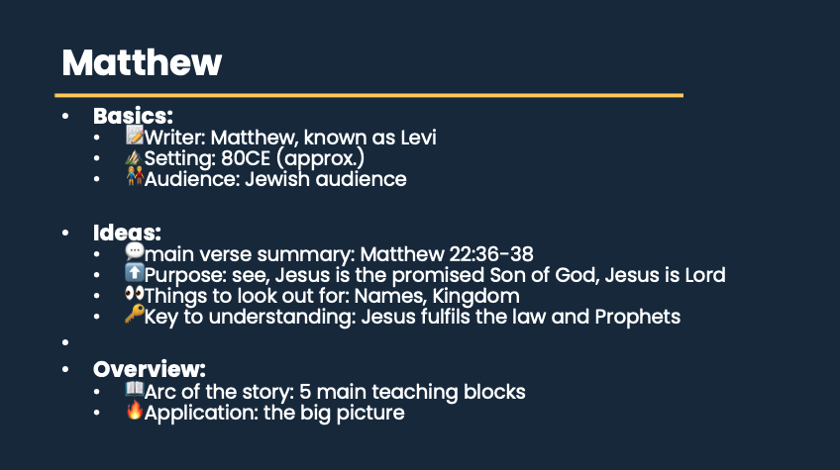

Slide 14
Mark
Basics:
  📝Writer: John Mark
  ⛰️Setting: 65-70CE (approx.)
  👫Audience: everyone
Ideas:
  💬main verse summary: Mark 1:1
  ⬆️Purpose: arrival of Jesus is good news!
  👀Things to look out for: Politics, repetition, irony
  🔑Key to understanding: fast-paced, action packed
Overview:
  📖Arc of the story: story-teller. 2 main parts (Signs & wonders/passion)
  🔥Application: Story of Jesus.

Slide 15
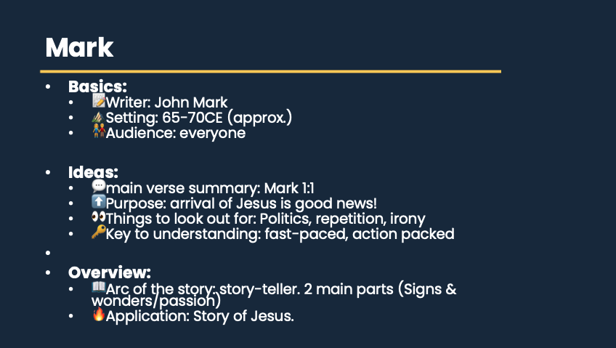

Slide 16
Luke
Basics:
  📝Writer: Luke
  ⛰️Setting: 80CE (approx.)
  👫Audience: Gentile converts
Ideas:
  💬main verse summary: Mark 1:3&4
  ⬆️Purpose: know the way of Jesus
  👀Things to look out for: Poverty/wealth, parables, women
  🔑Key to understanding: all Jesus began to do and teach, parables
Overview:
  📖Arc of the story: story-teller. Beginning to end
  🔥Application: what it looks like to follow Jesus.

Slide 17
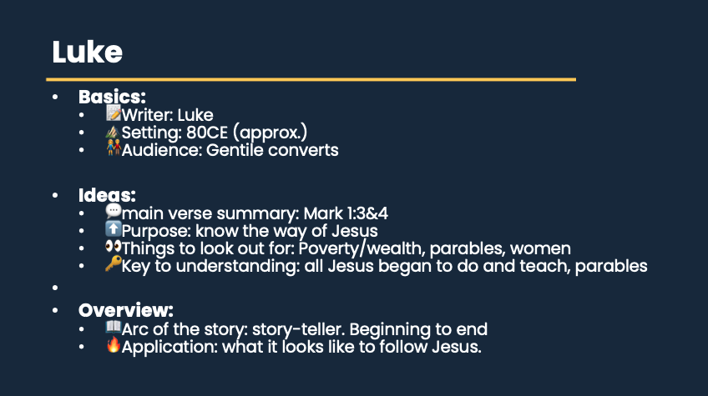

Slide 18
Discussion break:
Read Matthew 1:1, 18-25, Mark 1:1-15, Luke 1:1-4, 26-38 & John 1:1-18
  What is distinct?
  What does each Gospel author want to emphasise?

Slide 19
John
Basics:
  📝Writer: John
  ⛰️Setting: 90-100CE (approx.)
  👫Audience: everyone
Ideas:
  💬main verse summary: John 20:30-31
  ⬆️Purpose: Jesus as the divine, incarnate Son of God
  👀Things to look out for: Light & Darkness, #7 I am, #7 Signs
  🔑Key to understanding: simple, profound, theological, love & unity
Overview:
  📖Arc of the story: 4 main chunks, developed Christology
  🔥Application: Know love of God.

Slide 20
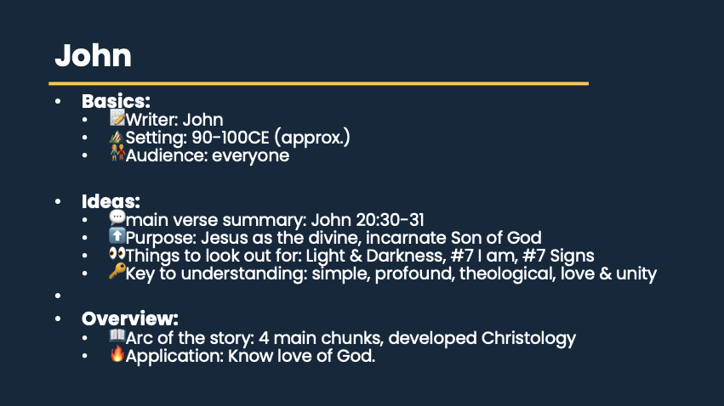

Slide 21
Discussion break:
Which Gospel would you recommend to a non-Christian wanting to know more about Jesus?
What parts of Jesus’ teaching have been most pivotal in your life?

Slide 22
Application
Reveal Jesus to us
  Roadmap 🗺️
  Co-ordinates 📍
  Lens 🔍
Hermeneutics

Slide 23
Overview
Gospels
  Matthew
  Mark
  Luke
  John
BIOs
  Basics
  Ideas
  Overview
The Gospels testify to the life, death and resurrection of Jesus Christ.
  Romans 5:8 “But God demonstrates his own love for us in this: While we were still sinners, Christ died for us.”

