Slide 1

Biographies of Jesus
Jessica Norman

Slide 2
Overview
Why do we have four Gospels?
This session will give you an overview of the four Gospels in the New Testament … exploring their similarities and differences and how each offers a distinctive view of Jesus.
Deepen our understanding
Reflect together
Gospels reveal Jesus

Slide 3

Gospels reveal Jesus
“If our theology is gospel-driven, the resurrection will permeate every facet of Christian thought. We can contemplate Christ only as the risen Lord.”
Michael Bird

Slide 4
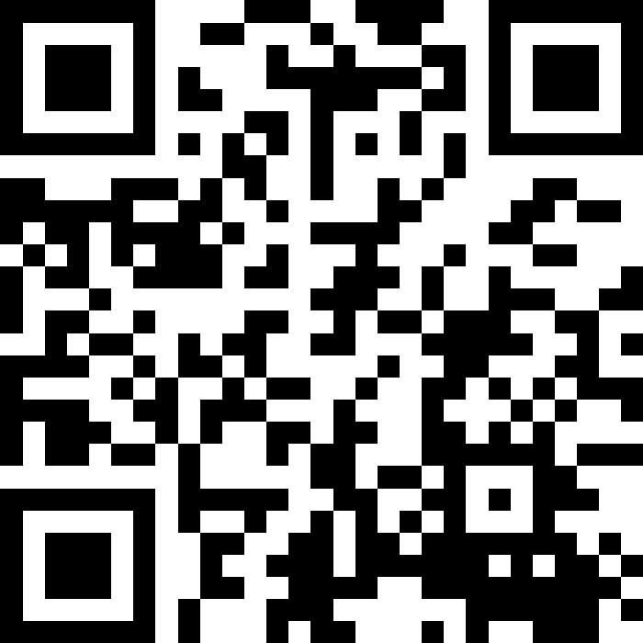

Got questions?

Slide 5
What are the Gospels?
Good News
Εὐαγγελίου - euangelion ”Good News”
Mark 1:1 “The beginning of the good news about Jesus the Messiah, the Son of God.”
Eyewitness Accounts
Testimonies
Biographies
Genre, closest to a Greco-Roman biography
Style
Word-count
Focus

Slide 6
Models
Diamond 💎
Images:
Matthew: Person 🧑
Mark: Lion 🦁
Luke: Ox 🐂
John: Eagle 🦅
CS Lewis
Liar 🥸
Lunatic 🤪
Lord ✝️

Slide 7
Synoptics
Mark
Matthew, Mark, Luke
John
Two source Hypothesis
Q
Matthew
Luke

Slide 8
Synoptics & John
Synoptics | John
John the Baptist’s ministry Jesus’ baptism The temptation of Jesus The healing of Peter’s mother-in-law The healing of a paralyzed man The call of Matthew/Levi The healing of a man with a withered hand The parable of the Sower and its interpretation The feeding of the five thousand Peter’s confession The first prediction of the passion The transfiguration The healing of an epileptic boy Jesus’ encounter with the rich, young ruler The triumphal entry into Jerusalem The cleansing of the temple The prediction of the temple’s destruction The “eschatological” discourse The preparation for the Passover The Lord’s Supper Jesus’ prayer in Gethsemane The arrest of Jesus Peter’s denial of Jesus Jesus’ appearance before Pilate | John the Baptist’s ministry Jesus’ baptism The temptation of Jesus The healing of Peter’s mother-in-law The healing of a paralyzed man The call of Matthew/Levi The healing of a man with a withered hand The parable of the Sower and its interpretation The feeding of the five thousand Peter’s confession The first prediction of the passion The transfiguration The healing of an epileptic boy Jesus’ encounter with the rich, young ruler The triumphal entry into Jerusalem The cleansing of the temple The prediction of the temple’s destruction The “eschatological” discourse The preparation for the Passover The Lord’s Supper Jesus’ prayer in Gethsemane The arrest of Jesus Peter’s denial of Jesus Jesus’ appearance before Pilate

Slide 9
Synoptics & John
Synoptics | John | Unique to John
John the Baptist’s ministry Jesus’ baptism The temptation of Jesus The healing of Peter’s mother-in-law The healing of a paralyzed man The call of Matthew/Levi The healing of a man with a withered hand The parable of the Sower and its interpretation The feeding of the five thousand Peter’s confession The first prediction of the passion The transfiguration The healing of an epileptic boy Jesus’ encounter with the rich, young ruler The triumphal entry into Jerusalem The cleansing of the temple The prediction of the temple’s destruction The “eschatological” discourse The preparation for the Passover The Lord’s Supper Jesus’ prayer in Gethsemane The arrest of Jesus Peter’s denial of Jesus Jesus’ appearance before Pilate | John the Baptist’s ministry Jesus’ baptism The temptation of Jesus The healing of Peter’s mother-in-law The healing of a paralyzed man The call of Matthew/Levi The healing of a man with a withered hand The parable of the Sower and its interpretation The feeding of the five thousand Peter’s confession The first prediction of the passion The transfiguration The healing of an epileptic boy Jesus’ encounter with the rich, young ruler The triumphal entry into Jerusalem The cleansing of the temple The prediction of the temple’s destruction The “eschatological” discourse The preparation for the Passover The Lord’s Supper Jesus’ prayer in Gethsemane The arrest of Jesus Peter’s denial of Jesus Jesus’ appearance before Pilate | Jesus washing the disciples feet The miracle of changing water into wine (2:1–11) The conversation with Nicodemus (3:1–21) The meeting with the Samaritan woman (4:1–42) The healing of a lame man at the pool of Bethesda (5:1–15) The healing of the man born blind (chap. 9) The raising of Lazarus (11:1–44) Jesus’ washing the disciples’ feet (13:1–17) The Farewell Discourses (chaps. 14–16) The high-priestly prayer (chap. 17) Jesus’ special resurrection appearance to Mary Magdalene (20:11–18) Jesus’ appearance to Thomas (20:24–29)

Slide 10
Discussion break:
How would you summarise the gospel in one sentence?
Why are the Gospels to be seen as good news?

Slide 11
Exploring the Gospels
Basics
Ideas
Overview

Slide 12
Exploring the Gospels
Basics:
📝Writer
⛰️Setting
👫Audience
Ideas:
💬main verse summary
⬆️Purpose
👀Things to look out for
🔑Key to understanding
Overview:
📖Arc of the story
🔥Application

Slide 13
Matthew
Basics:
📝Writer: Matthew, known as Levi
⛰️Setting: 80CE (approx.)
👫Audience: Jewish audience
Ideas:
💬main verse summary: Matthew 22:36-38
⬆️Purpose: see, Jesus is the promised Son of God, Jesus is Lord
👀Things to look out for: Names, Kingdom
🔑Key to understanding: Jesus fulfils the law and Prophets
Overview:
📖Arc of the story: 5 main teaching blocks
🔥Application: the big picture

Slide 14
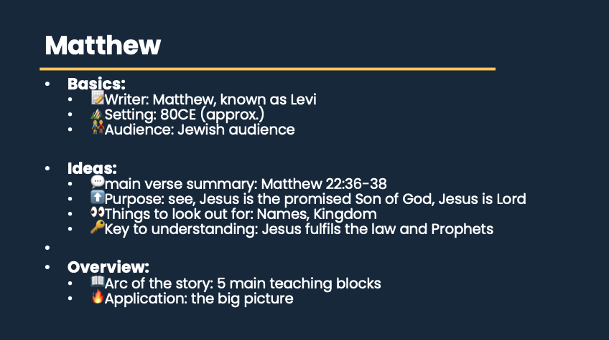

Slide 15
Mark
Basics:
📝Writer: John Mark
⛰️Setting: 65-70CE (approx.)
👫Audience: everyone
Ideas:
💬main verse summary: Mark 1:1
⬆️Purpose: arrival of Jesus is good news!
👀Things to look out for: Politics, repetition, irony
🔑Key to understanding: fast-paced, action packed
Overview:
📖Arc of the story: story-teller. 2 main parts (Signs & wonders/passion)
🔥Application: Story of Jesus.

Slide 16
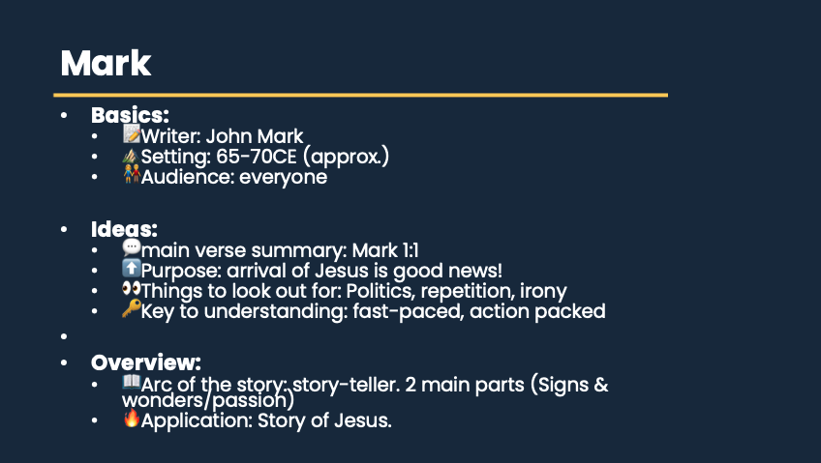

Slide 17
Luke
Basics:
📝Writer: Luke
⛰️Setting: 80CE (approx.)
👫Audience: Gentile converts
Ideas:
💬main verse summary: Luke 1:3&4
⬆️Purpose: know the way of Jesus
👀Things to look out for: Poverty/wealth, parables, women
🔑Key to understanding: all Jesus began to do and teach, parables
Overview:
📖Arc of the story: story-teller. Beginning to end
🔥Application: what it looks like to follow Jesus.

Slide 18
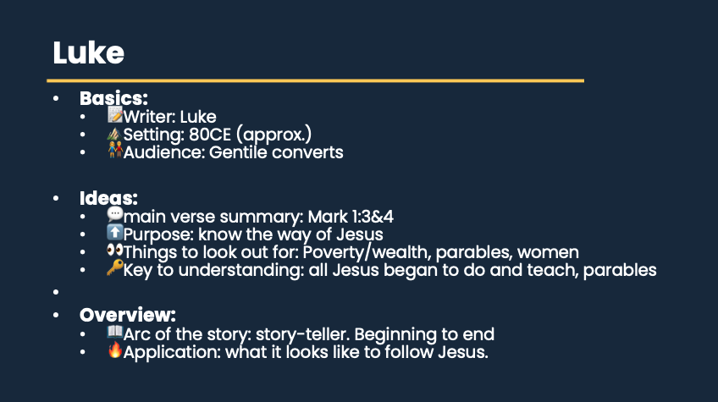

Slide 19
Discussion break:
Read Matthew 1:1, 18-25, Mark 1:1-15, Luke 1:1-4, 26-38 & John 1:1-18
What is distinct?
What does each Gospel author want to emphasise?

Slide 20
John
Basics:
📝Writer: John
⛰️Setting: 90-100CE (approx.)
👫Audience: everyone
Ideas:
💬main verse summary: John 20:30-31
⬆️Purpose: Jesus as the divine, incarnate Son of God
👀Things to look out for: Light & Darkness, #7 I am, #7 Signs
🔑Key to understanding: simple, profound, theological, love & unity
Overview:
📖Arc of the story: 4 main chunks, developed Christology
🔥Application: Know love of God.

Slide 21
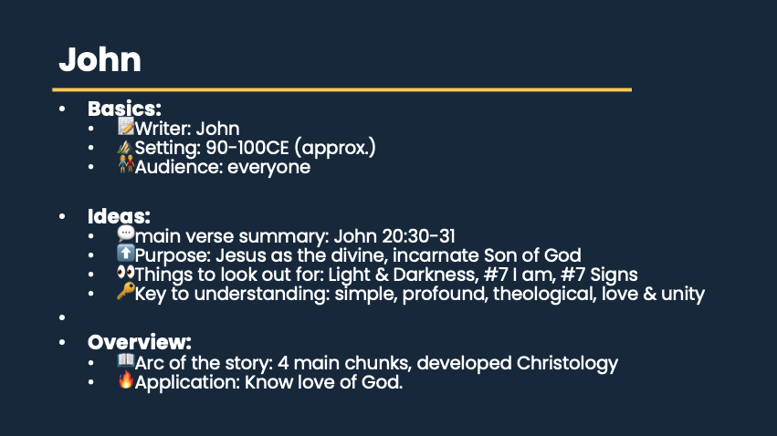

Slide 22
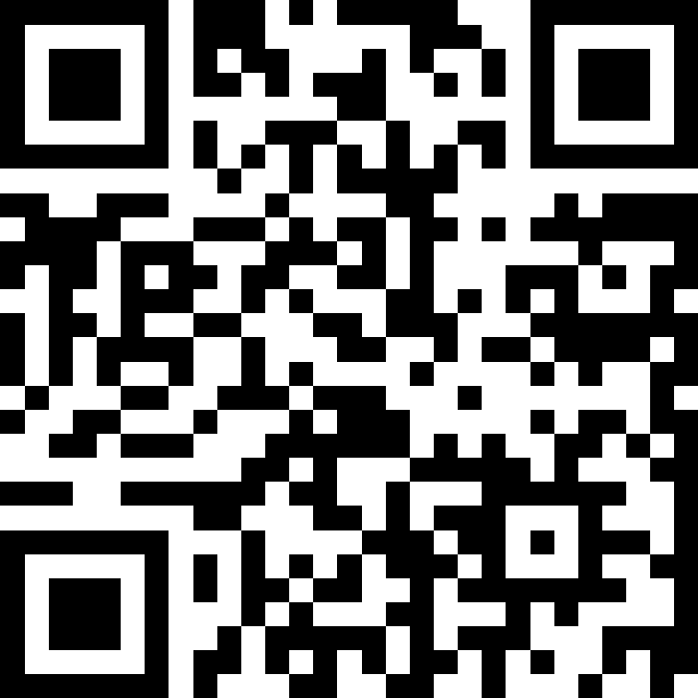
Discussion break:
What parts of Jesus’ teaching have been most transformative in your life?

Slide 23
Application
Reveal Jesus to us
Roadmap 🗺️
Co-ordinates 📍
Lens 🔍
Hermeneutics

Slide 24
Overview
Gospels
Matthew
Mark
Luke
John
BIOs
Basics
Ideas
Overview
The Gospels testify to the life, death and resurrection of Jesus Christ.
Romans 5:8 “But God demonstrates his own love for us in this: While we were still sinners, Christ died for us.”

