Slide 1
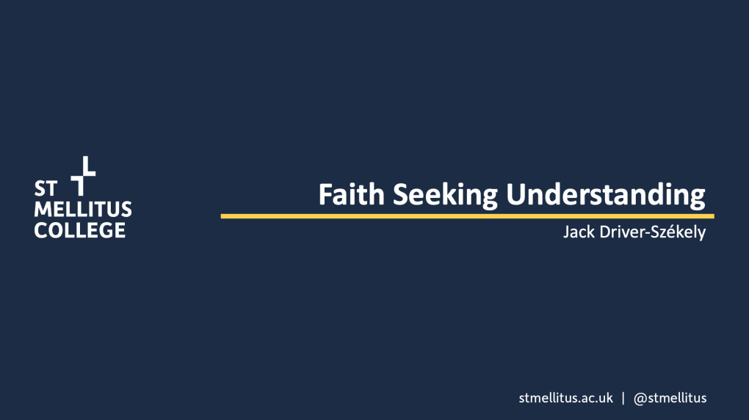

Slide 2


Slide 3





FAITH SEEKING UNDERSTANDING
IS IT WRONG TO KNOW THINGS?
CAN I FIND GOD?
HOW DOES GOD FIND US?

Slide 4
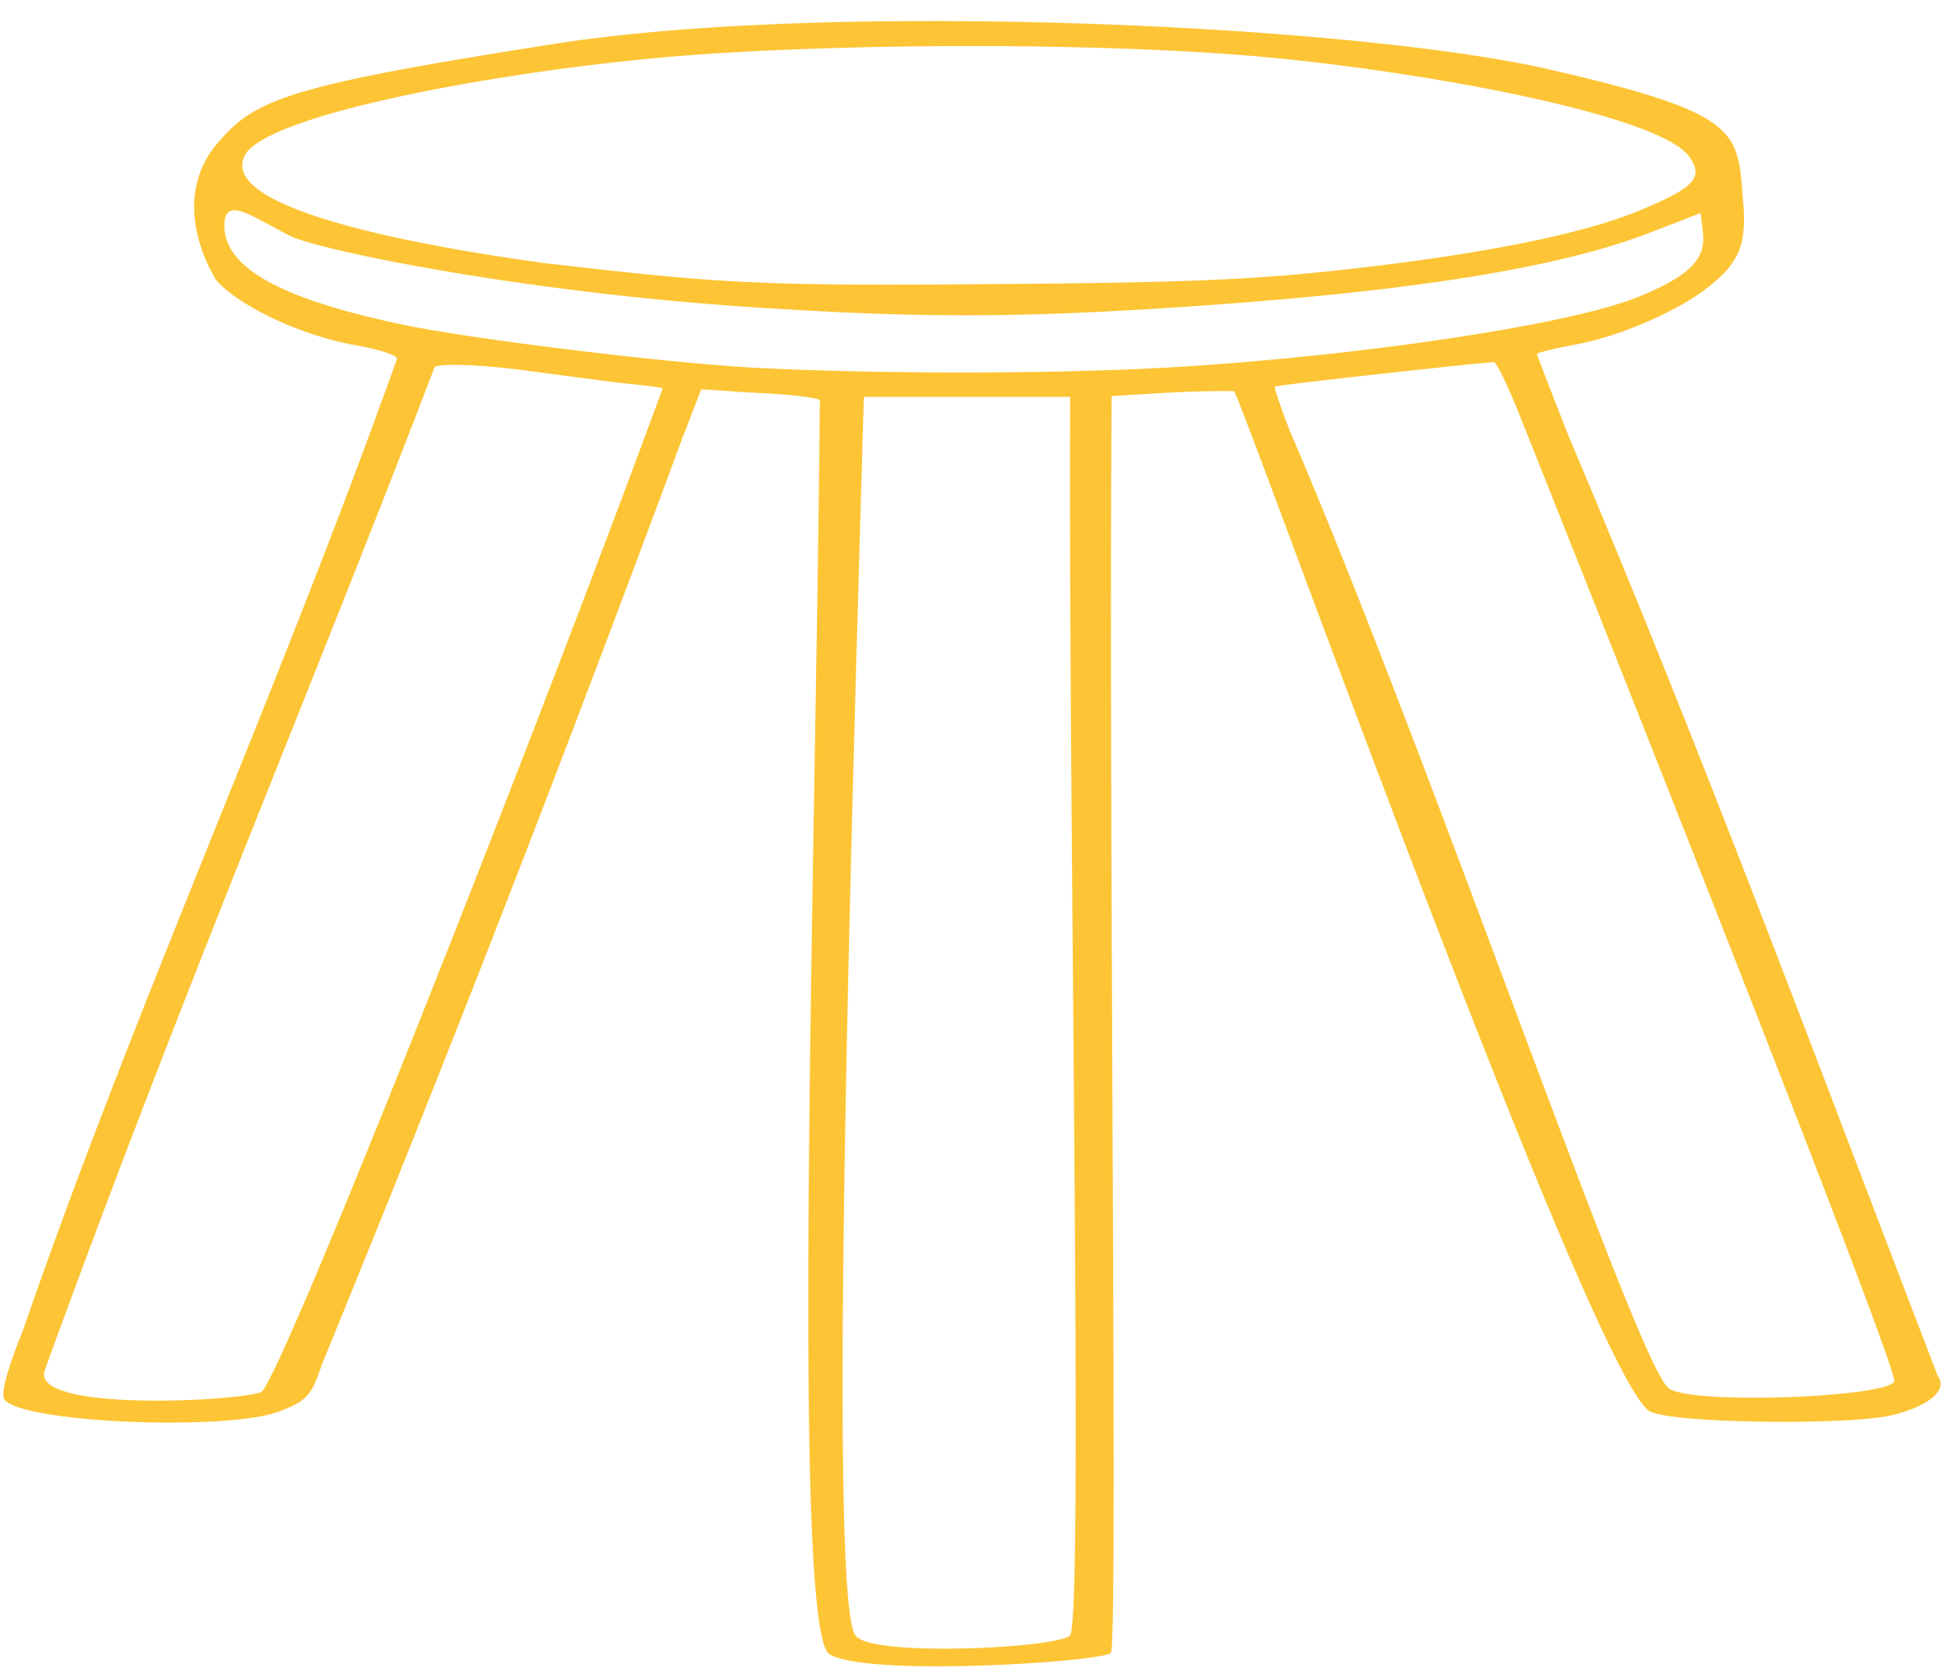
IS IT WRONG TO KNOW THINGS?
The Problem We Face
Theologia = Reasoned Talk About God
Three legs of theology
Trust in the Lord with all your heart and lean not on your own understanding; in all your ways submit to him, and he will make your paths straight. (Proverbs 3:5-6 NIV)
Biblical
Doctrine
Practical
Si comprehendis non est Deus (loose trans: If you can get your mind around it, it's not God.) (Augustine)

Slide 5
IS IT WRONG TO KNOW THINGS?
The Fears Of Doctrine
Irrelevant
Trust in the Lord with all your heart and lean not on your own understanding (Proverbs 3:5-6)
Overly Complicated
It is important to note that this is a complex theological concept that has been debated and discussed for centuries by theologians and scholars (Chat GPT)
Unnecessary
We don’t need theology we just need Jesus.

Slide 6
IS IT WRONG TO KNOW THINGS?
You are a theologian!
We practice theology whenever we think or speak about God. We are doing theology when we pray, worship, read Scripture, teach others about the faith and make decisions about how to live in a right relationship to God. In this sense, every Christian practices theology every day. (Keith Johnson)
GOD IS GOOD
Functional theology (J.Todd Billings)

Slide 7

DISCUSSION

Slide 8
CAN I FIND GOD?
Sources of Theology
Sources are the relevant data for the theological task, whereas the norm determines how the data will be used (James Cone)
Scripture
How does the Church’s interpretation (i.e. tradition) regulate our reading the Bible?

Slide 9
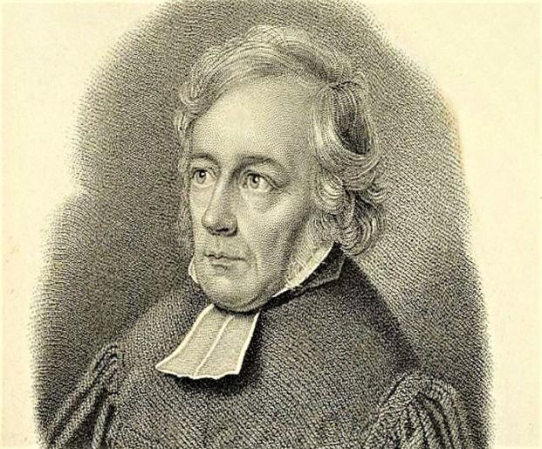
CAN I FIND GOD?
Experience
The feeling of absolute dependence.
How do I know God?
Natural Theology
  In the act of creation, God establishes a union with humanity that is distinct from the saving union that God establishes with humanity in Christ.
  Humans possess some form of natural capacity to know God that remains intact after humans fall into sin.

Slide 10
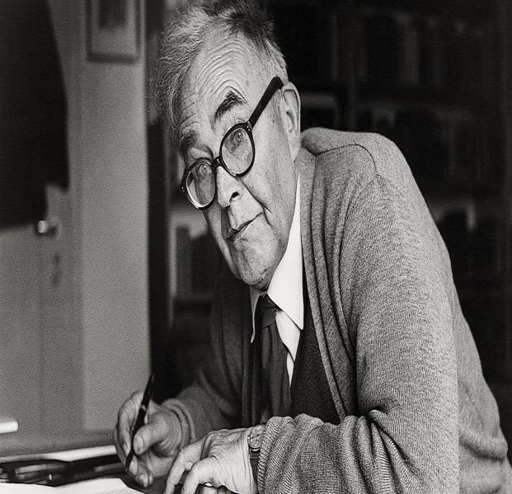
CAN I FIND GOD?
The Great War
during this period that Protestant liberal theology finally “unmasked itself ” to him as a human‐centered enterprise (Karl Barth)
Theology of KRISIS
God is different and distinct from us.
The transcendent God judges and negates creaturely history by breaking into it from the outside.
The centre of this miracle is the resurrection of Jesus Christ.
knowledge of God is an “impossible possibility,” (Karl Barth)

Slide 11
DISCUSSION

Slide 12
HOW DOES GOD FIND US?
Revelation
God’s revelation in Christ does not reveal something that humans “basically already know” as a result of their creation.
Sin produces an “irreconcilable contradiction” between God and humans. (Karl Barth)
Faith as a Gift
The Point of Contact
Faith is a “miracle that cannot be interpreted anthropologically” (Karl Barth)

Slide 13
