Slide 1


Slide 2
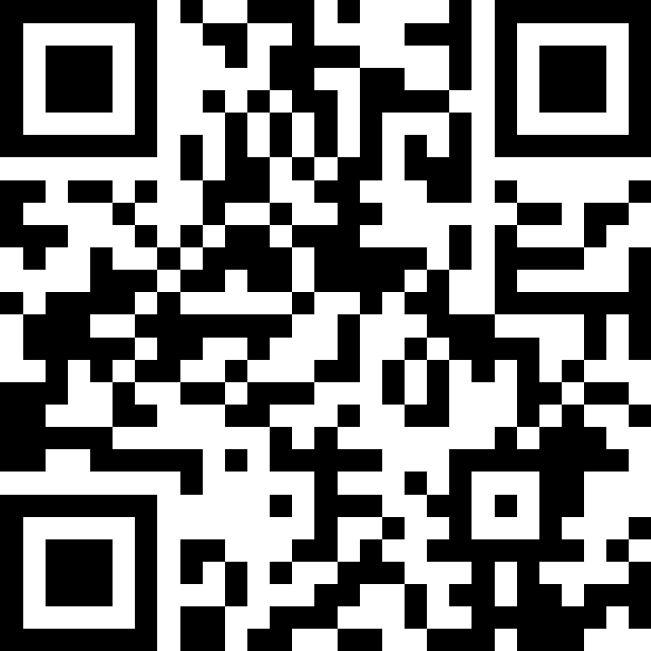

Slide 3

IN OTHER WORDS, THEOLOGIANS- AS ALL CHRISTIANS- ARE A NEEDY PEOPLE, ONES WHO DEPEND UPON A PARACLETE/ADVOCATE/COMFORTER (CF. JN.14:16,26) WHO IS BOTH WITH US AND IN US SO AS TO “DE-SUBJECTIFY” AND
“RE-SUBJECTIFY” OUR VERY SELVES AT DIFFERENT CONSTITUTIVE REGISTERS, INCLUDING THE AFFECTIVE. WE HAVE BEEN PROMISED BY CHRIST THAT HIS DEPARTURE WILL NOT LEAVE US ORPHANED (CF. JN 14:18)…. WE MUST GIVE SPACE AND BE RECEPTIVE TO THE SPIRIT’S HELP (ROM. 8:26) IN ORDER TO CARRY ON FAITHFULLY AND COURAGEOUSLY BEFORE OUR FEARS.
Daniel Castelo, ‘Holy Spirit’, in The New Cambridge Companion to Christian Doctrine, 133.

Slide 4




THE HOLY SPIRIT
WHO
WHAT
HOW
is the Holy Spirit?
is the Church?
do I believe in the Holy Spirit?

Slide 5

WHO
is the Holy Spirit?
Old Testament
The Spirit is always associated with deep experiences, experiences of an awesome power
RUACH
Wind: Exodus 14.21
Breadth: Genesis 2:7 ; Ezekiel 37:9-10
Charism: Genesis 41:38-9 ; 1 Samuel 16:13
‘the Spirit of God is presented by the Old Testament as God’s creative, sustaining, saving, and renewing power who rescues not only individuals but the entire people of God from the forces of self-destruction.’
Daniel Migliore, Faith Seeking Understanding, 236.

Slide 6
WHO
is the Holy Spirit?
New Testament
All f our Gospels recall the descent of HS on Jesus at his baptism / Matthew & Luke recall activity at the birth too
PARAKLÊTOS - John 14
In Acts Holy Spirit seen in POWERFUL & PERSONAL ways
POWERFUL: People ‘filled’ (Acts 2:4; 4:8; 9:17; 13:9), acts in the Spirit (Acts 19:21) and through Spirit (Acts 21:4)
PERSONAL: §Speaks (Acts 1:16; 8:29; 10:19; 11:12; 13:2; 28:25), bears witness (Acts 5:32; 20:23); snatches (Acts 8:39); sends (Acts 13:4); thinks good (Acts 15:28), forbids (Acts 16:6), prevents (Acts 16:7), appoints (Acts 20:28), is lied to (Acts 5:3), put to the test (Acts 5:9) and resisted (Acts 7:51).

Slide 7
WHO
is the Holy Spirit?
Fully God?
The more the Spirit is conceived as ‘the power of God’ or ‘a mode of God’s presence’, the less difficulty there is, at one level, of speaking of the Spirit’s divinity
Basil the Great
“according to the co-ordination of words delivered in baptism, the relation of the Spirit to the Son is the same as that of the Son to the Father. And if the Spirit is co-ordinate with the Son, and the Son with the Father, it is obvious that the Spirit is also co-ordinate with the Father.” (XVII.43)
The Gloria: “to the Father, through the Son, in the Spirit” → “to the Father, with the Son, and with the Spirit

Slide 8
WHO
is the Holy Spirit?
Fully God?
Basil the Great
All who are in need of sanctification turn to the Spirit; all those seek him who live by virtue… He is not a being who needs to restore his strength, but himself supplies life. (IX, 23)
It is impossible for you to recognise Christ, the image of the invisible God unless the Spirit enlightens you. And impossible to worship the Son save by the Holy Spirit. Impossible to call upon the Father save by the Spirit of adoption. (XI.27)

Slide 9
WHO
is the Holy Spirit?
Fully God?
Augustine
‘Yet Scripture has not said: “the Holy Spirit is love”. If it had, much of our inquiry would have been rendered unnecessary. Scripture does indeed say: “God is love” (1 John 4:8,16); and so leaves us to ask whether it is God the Father, or God the Son, or God the Holy Spirit, or or the Trinity itself, who is love’ (On The Trinity, XV.xvii.27-xviii.32)
Bond of Unity
Holy Spirit

Slide 10
WHO
is the Holy Spirit?
THE HOLY SPIRIT IS FULLY AND COMPLETELY GOD

Slide 11

HOW DO WE SEE THE SAME HOLY SPIRIT IN THE OLD AND NEW TESTAMENT? WHAT ROLE DOES THE HOLY SPIRIT PLAY IN YOUR FAITH?

Slide 12
WHAT
is the Church?
We believe in the Holy Spirit,
the Lord, the giver of life,
who proceeds from the Father and the Son,
who with the Father and the Son
is worshipped and glorified,
who has spoken through the prophets.
We believe in one holy catholic and apostolic Church.
We acknowledge one baptism
for the forgiveness of sins.
We look for the resurrection of the dead,
and the life of the world to come.
Amen.

Slide 13
WHAT
is the Church?
Acts 1
They gathered in one place: 13a When they arrived, they went upstairs to the room where they were staying.
They were known: 13bThose present were Peter, John, James and Andrew; Philip and Thomas, Bartholomew and Matthew; James son of Alphaeus and Simon the Zealot, and Judas son of James.
They worshipped: 14They all joined together constantly in prayer, along with the women and Mary, the mother of Jesus, and with his brothers.
They had a structure and prayed to God for help to build it: 23 So they nominated two men: Joseph called Barsabbas (also known as Justus) and Matthias. 24 Then they prayed, “Lord, you know everyone’s heart. Show us which of these two you have chosen

Slide 14
WHAT
is the Church?
Acts 2
But the gathering we see in Acts 1 is not yet the church. Tom Greggs, Dogmatic Ecclesiology, 12.
Without this Spirit, the church (so-called) remains a shut-away society in an upper room. Tom Greggs, Dogmatic Ecclesiology, 13.
the church is a community which is a creation of the event of the intensity of the Holy Spirit economy of grace in redeeming creation. Tom Greggs, Dogmatic Ecclesiology, 2..

Slide 15
WHAT
is the Church?
Whose is the Church?
It is God's own grace which enables humanity to share in communion with God and with others in the community. Many accounts of the church suggest that the church occurs as an expression of the natural human desire to form community. By such an account, the church is the wishful religious community of like-minded people.... Even where societies exist, they do so very often to diminish competition between hearts turned in on themselves (as one finds in war or anarchy), or else they exist for the good of the individuals who themselves benefit from cooperation (a corporate form of the heart turned in on itself).
Tom Greggs, Dogmatic Ecclesiology, 12.

Slide 16
WHAT
is the Church?
THE CHURCH EXISTS BECAUSE OF THE HOLY SPIRIT
Faithful attendance to the Spirit's
activity is needed, but overconfidence that human activity is the condition of or even is divine activity must be guarded against
Tom Greggs, Dogmatic Ecclesiology, 10.

Slide 17
HOW MIGHT YOU DISTINGUISH THE HOLY SPIRIT FROM YOUR EXPERIENCE??

Slide 18
HOW
do I believe in he Holy Spirit?
Enables all to relate to God
the name “Spirit” should primarily serve to remind us that God is beyond gender and that we must avoid the danger of making idols of any images and metaphors of God (Daniel Migliore, Faith Seeking Understanding, 245)
Preparing Hearts
The Spirit is seen as active in the world, preparing hearts and minds for an encounter with God’ (Daniel Migliore, Faith Seeking Understanding, 295)

Slide 19
HOW
do I believe in he Holy Spirit?
Illumination
Now we shall have a right definition of faith if we say that it is steady and certain knowledge of the divine benevolence towards us, which is founded upon the truth of the gracious promise of God in Christ, and is both revealed to our minds and sealed in our hearts by the Holy Spirit.’ (John Calvin, Institutes, III.ii, 7)
Renewal
‘The Spirit prepares people, and goes out to them with his grace, in order to draw them to Christ. The Spirit manifests the risen Lord to them, recalls his word to them and opens their minds to the understanding of his Death and Resurrection.’ (Catechism of the Catholic Church, §737)

Slide 20
HOW
do I believe in he Holy Spirit?
THE HOLY SPIRIT CANNOT BE REDUCED TO A HE OR ME?

Slide 21
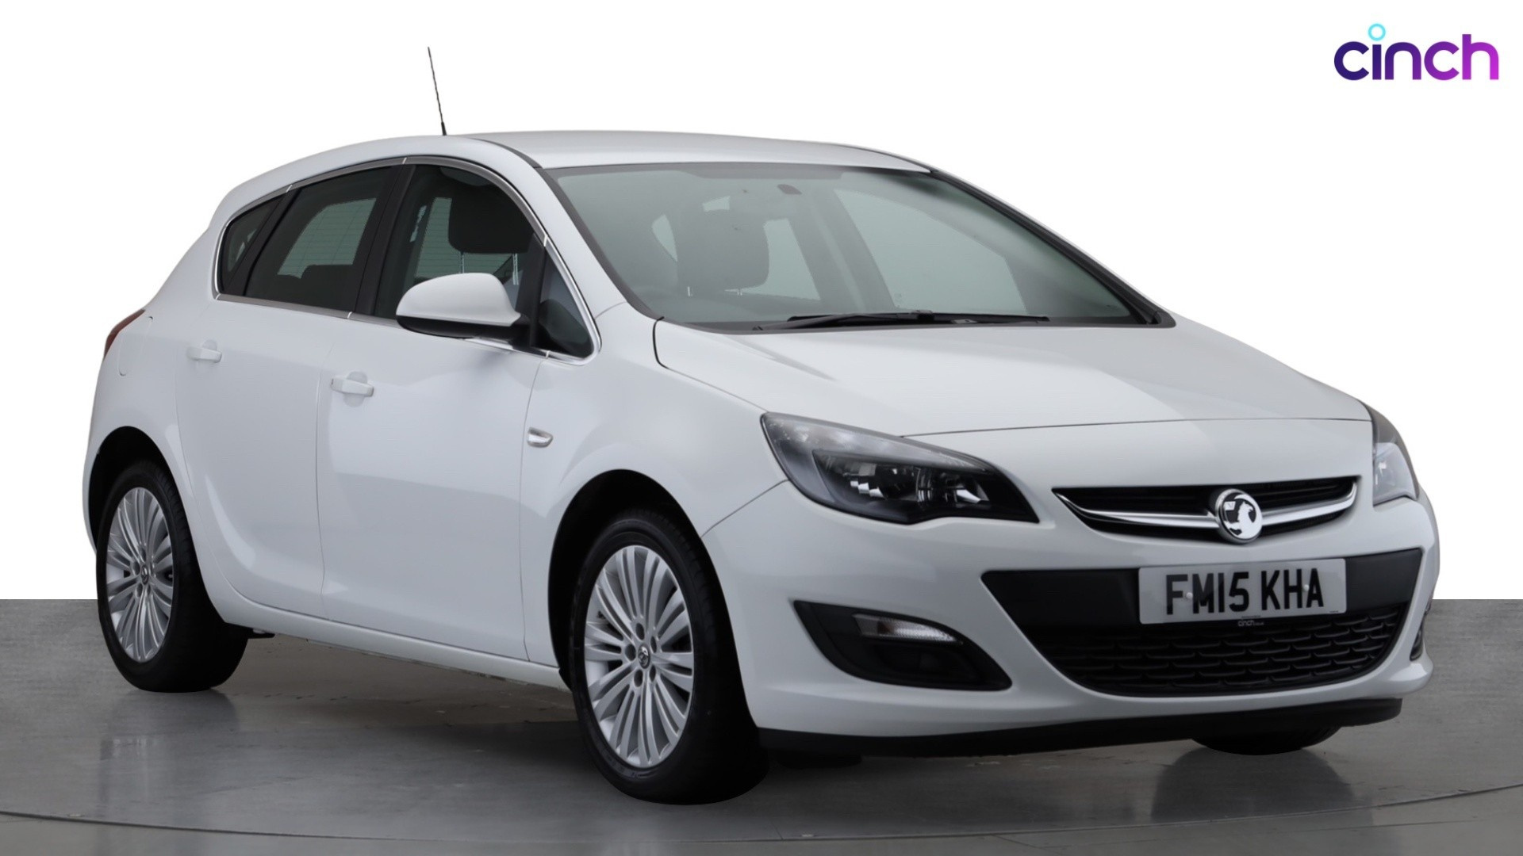

Slide 22
THE HOLY SPIRIT
The Holy Spirit is fully and completely God
The Church exists because of the holy Spirit
The Holy Spirit cannot be reduced to a HE or ME

Slide 23
IN OTHER WORDS, THEOLOGIANS- AS ALL CHRISTIANS- ARE A NEEDY PEOPLE, ONES WHO DEPEND UPON A PARACLETE/ADVOCATE/COMFORTER (CF. JN.14:16,26) WHO IS BOTH WITH US AND IN US SO AS TO “DE-SUBJECTIFY” AND
“RE-SUBJECTIFY” OUR VERY SELVES AT DIFFERENT CONSTITUTIVE REGISTERS, INCLUDING THE AFFECTIVE. WE HAVE BEEN PROMISED BY CHRIST THAT HIS DEPARTURE WILL NOT LEAVE US ORPHANED (CF. JN 14:18)…. WE MUST GIVE SPACE AND BE RECEPTIVE TO THE SPIRIT’S HELP (ROM. 8:26) IN ORDER TO CARRY ON FAITHFULLY AND COURAGEOUSLY BEFORE OUR FEARS.
Daniel Castelo, ‘Holy Spirit’, in The New Cambridge Companion to Christian Doctrine, 133.

