Slide 1


GOD
one
jack.driver-szekely@stmellitus.ac.uk

Slide 2

THE DOCTRINE OF THE TRINITY IS WIDELY REGARDED AS ONE OF THE MOST DIFFICULT ASPECTS OF CHRISTIAN THEOLOGY
Alister McGrath, Christian Theology: An Introduction. Sixth Edition (West Sussex: Wiley Blackwell Publishers Ltd., 2017), 299.

Slide 3





WHAT IS THE TRINITY?
HOW
WHERE
WHAT
do we describe the Trinity?
does the language come from?
are some of the key terms?

Slide 4



WHAT IS THE TRINITY?
WHEN
WHY
WHO
do we need to be careful with what we say?
is the Trinity important?
is the ONE God?

Slide 5
HOW
WHERE
WHAT
WHAT IS THE TRINITY?
WHEN
WHY
WHO

Slide 6
HOW
do we describe the Trinity?
Irrelevant
Trust in the Lord with all your heart and lean not on your own understanding (Proverbs 3:5-6)

Slide 7
HOW
do we describe the Trinity?
Irrelevant
Overly Complicated
It is important to note that this is a complex theological concept that has been debated and discussed for centuries by theologians and scholars (Chat GPT)

Slide 8
HOW
do we describe the Trinity?
Irrelevant
Overly Complicated
Unnecessary
We don’t need theology we just need Jesus.

Slide 9
HOW
do we describe the Trinity?
SI COMPREHENDIS NON EST DEUS
If you can get your mind around it, it's not God

Slide 10


HOW
do we describe the Trinity?
Chain
Spring
Chord
ANALOGIES
OF THE TRINITY
Shamrock
H20

Slide 11
ONE GOD IN ESSENCE, DISTINGUISHED IN THREE PERSONS
mia ousia, treis hypostaseis

Slide 12
WHERE
does the language come from?
Shema: שְׁמַע יִשְׂרָאֵל
Hear, O Israel: YHWH is our God, YHWH is one (Deut 6:4)
“The most important one,” answered Jesus, “is this: ‘Hear, O Israel: The Lord our God, the Lord is one.
(Mark 12:29

Slide 13
WHERE
does the language come from?
Shema: שְׁמַע יִשְׂרָאֵל
Trinity?
Seems to be just 2 verses (Mt. 28:19 & 2 Cor. 13:13)
Wisdom, Word of God, Spirit of God
'Trinitarian theology is not an attempt to know God apart from the biblical witness. Rather, its efforts must always be rooted, guided, and disciplined by this witness’
D.L. Migliore. Faith Seeking Understanding: An Introduction to Christian Theology. Third Edition (Grand Rapids: Eerdmans, 2014), 71.

Slide 14
WHERE
does the language come from?
Shema: שְׁמַע יִשְׂרָאֵל
Trinity?
Doctrine of Revelation
Preached, Written, Revealed
Revealer, Revelation, Being Revealed (Karl Barth)

Slide 15

HAVE YOU EVER CONSIDERED THAT ONLY GOD REVEALS GODSELF? WHY DOES THIS MATTER?

Slide 16
WHAT
are some of the key terms?
The vocabulary associated with the doctrine of the Trinity is unquestionably one of the biggest difficulties for students (Alister McGrath)

Slide 17
WHAT
are some of the key terms?
The vocabulary associated with the doctrine of the Trinity is unquestionably one of the biggest difficulties for students (Alister McGrath)
Trinitas
Trinity

Slide 18
WHAT
are some of the key terms?
The vocabulary associated with the doctrine of the Trinity is unquestionably one of the biggest difficulties for students (Alister McGrath)
Trinitas
Persona
Often translated ‘person’ but literally means “a mask”
Behind the many roles was one actor!

Slide 19
WHAT
are some of the key terms?
The vocabulary associated with the doctrine of the Trinity is unquestionably one of the biggest difficulties for students (Alister McGrath)
Trinitas
Persona
Substantia
That which they have in common

Slide 20
WHAT
are some of the key terms?
The vocabulary associated with the doctrine of the Trinity is unquestionably one of the biggest difficulties for students (Alister McGrath)
Trinitas
Persona
Substantia
PERSON differentiates & SUBSTANCE unites

Slide 21
WHEN
do we need to be careful with what we say?
The Early Church Councils
Council of Nicea (AD 325) and Constantinople (AD 381)
I believe
opera trinitatis ad extra indivisa sunt (“the outward actions of the Trinity are indivisible”)

Slide 22
WHEN
do we need to be careful with what we say?
The Early Church Councils
Appropriations
The ancient practice of attributing to one person of the Trinity a characteristic or action which is in fact common to the Trinity as a whole.

Slide 23
WHEN
do we need to be careful with what we say?
The Early Church Councils
Appropriations
Perichoresis
The manner in which the three persons relate to one another

Slide 24
WHEN
do we need to be careful with what we say?
The Early Church Councils
Appropriations
Perichoresis
East & West
East: Emphasise diversity & individuality
West: Begins with Unity

Slide 25
WHEN
do we need to be careful with what we say?
HERESY!
Adoptionism
Jesus Christ is distinct from the Father, but Jesus was not always God.
Subordinationism
Jesus Christ is distinct from the Father and in some ways lesser than the Father.
Trithesism
Three different Gods- this is the attempt to maintain distinction

Slide 26
WHEN
do we need to be careful with what we say?
What does One mean?
Creation as GRACE
Our language informed by God not us!

Slide 27
WHAT HAS CHANGED IN YOUR UNDERSTANDING OF THE TRINITY? WHY IS IT IMPORTANT THAT GOD IS ONE?

Slide 28
WHY
is the Trinity important?
Aids us in our speech
“It is the business of the doctrine of the Trinity, to answer the question who God is [and to distinguish] the Christian doctrine of God as Christian… in contrast to all other possible doctrines of God.” (Karl Barth)

Slide 29
WHY
is the Trinity important?
Aids us in our speech
Secondary to God
'The Christian confession of God as triune is a summary description of the witness of Scripture to God's unfathomable love incarnate in Jesus Christ and active by the power of the Spirit in the community of faith today. The doctrine of the Trinity is the always-inadequate attempt to interpret this witness in the most suitable images and concepts available to the church in a particular era.' (Daniel Migliore)

Slide 30
WHY
is the Trinity important?
Aids us in our speech
Secondary to God
Protective Doctrine
It is how we point to God

Slide 31
WHO
is our ONE God?
The Greatest Commandment
2﻿8 One of the teachers of the law came and heard them debating. Noticing that Jesus had given them a good answer, he asked him, “Of all the commandments, which is the most important?” 29 “The most important one,” answered Jesus, “is this: ‘Hear, O Israel: The Lord our God, the Lord is one. 30 Love the Lord your God with all your heart and with all your soul and with all your mind and with all your strength.’ (Mark 12:28-30)

Slide 32
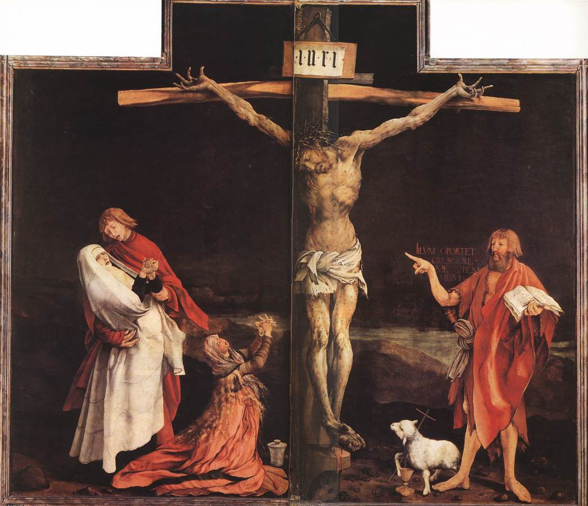

Slide 33
WHO
is our ONE God?
The Greatest Commandment
The Ministry of the Pointing Hand
We are NOT God

Slide 34
WHO
is our ONE God?
The Greatest Commandment
The Ministry of the Pointing Hand
The Proper Name of God
Father, Son and Holy Spirit

Slide 35
WHO
is our ONE God?
The Greatest Commandment
The Ministry of the Pointing Hand
The Proper Name of God

Slide 36
SO IN THE END, WE MUST SAY THAT A DOCTRINE OF GOD CANNOT BUT TAKE THE WINGS OF PRAYER. THERE IS NO STUDY, NO EXAMINATION NOR UNDERSTANDING, WITHOUT A HEART SEARCHED BY INTERCESSION, BY REPENTANCE, BY WORSHIP AND PRAISE. THE OBJECTIVITY OF GOD- THIS BEAUTEOUS LIGHT- BRINGS FORTH FROM THE CREATURES WHO BEHOLD IT A WONDER THAT LIES BEYOND SAYING. THE SUBJECTIVITY OF GOD- THIS LIVING ONE- KINDLES THE FIERY LOVE THAT IS THE LORD’S OWN GIFT, SET ABLAZE IN THE CREATURE’S HEART. THIS IS THE PROPER DOGMATIC FORM OF THE DOCTRINE OF GOD: THE INTELLECT BENT DOWN, GLORIFIED, IN PRAYER
Katherine Sonderegger

Slide 37
GOD
one
jack.driver-szekely@stmellitus.ac.uk

