Slide 1

Letters to Churches
Dr. Jared Neusch

Slide 2
Learning Paul
13 of the NT letters name Paul as author
Biography drawn from Acts and Paul’s letters
Descended from tribe of Benjamin
Pharisee, raised in Tarsus
Roman citizen
Worked with his hands

Slide 3
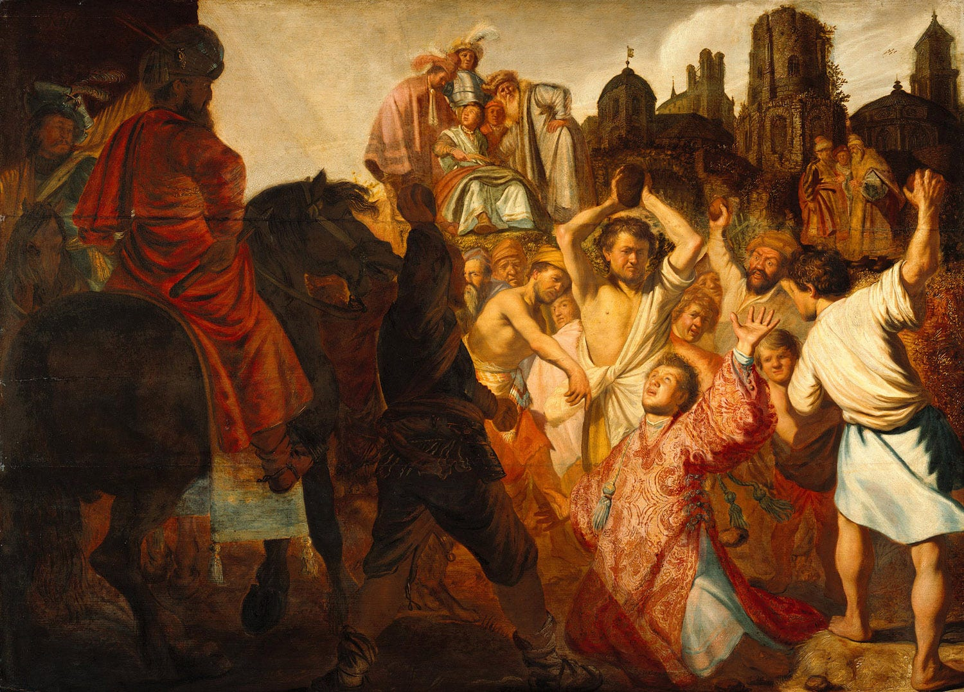
Meeting Paul
“The Stoning of Saint Stephen” Rembrandt

Slide 4
Acts 9:1-19
“Meanwhile Saul, still breathing threats and murder against the disciples of the Lord, went to the high priest 2 and asked him for letters to the synagogues at Damascus, so that if he found any who belonged to the Way, men or women, he might bring them bound to Jerusalem. 3 Now as he was going along and approaching Damascus, suddenly a light from heaven flashed around him. 4 He fell to the ground and heard a voice saying to him, “Saul, Saul, why do you persecute me?” 5 He asked, “Who are you, Lord?” The reply came, “I am Jesus, whom you are persecuting. 6 But get up and enter the city, and you will be told what you are to do.” 7 The men who were traveling with him stood speechless because they heard the voice but saw no one. 8 Saul got up from the ground, and though his eyes were open, he could see nothing;[a] so they led him by the hand and brought him into Damascus. 9 For three days he was without sight and neither ate nor drank.

Slide 5
Acts 9:1-19
“10 Now there was a disciple in Damascus named Ananias. The Lord said to him in a vision, “Ananias.” He answered, “Here I am, Lord.” 11 The Lord said to him, “Get up and go to the street called Straight, and at the house of Judas look for a man of Tarsus named Saul. At this moment he is praying, 12 and he has seen in a vision a man named Ananias come in and lay his hands on him so that he might regain his sight.” 13 But Ananias answered, “Lord, I have heard from many about this man, how much evil he has done to your saints in Jerusalem, 14 and here he has authority from the chief priests to bind all who invoke your name.” 15 But the Lord said to him, “Go, for he is an instrument whom I have chosen to bring my name before gentiles and kings and before the people of Israel; 16 I myself will show him how much he must suffer for the sake of my name.” 17 So Ananias went and entered the house. He laid his hands on Saul and said, “Brother Saul, the Lord Jesus, who appeared to you on your way here, has sent me so that you may regain your sight and be filled with the Holy Spirit.” 18 And immediately something like scales fell from his eyes, and his sight was restored. Then he got up and was baptized, 19 and after taking some food, he regained his strength.”

Slide 6
Paul, the author
Disputed Ephesians Colossians 2 Thessalonians 1 Timothy 2 Timothy Titus | Undisputed Romans Galatians Philippians 1 Corinthians 2 Corinthians 1 Thessalonians Philemon

Slide 7
Paul vs “Pauline”
Eschatology
Literary Features
Grammar / Vocabulary
Tone
Additional Factors

Slide 8
Paul and Particularity
WHO is Paul?
WHO is Paul writing to?
WHEN is he writing it?
WHY is he writing?

Slide 9
Discussion
How might the specific context of one of Paul’s letters impact our interpretation and application of the text?

Slide 10
Galatians
When? Written 48-52 CE
Who? To the churches in Galatia. There is a lively debate on whether it is northern Galatia or Southern Galatia.
Why? Paul discovers that a rival teaching faction (many now call the “Teachers”) have come into his church he planted in Galatia. (1:6-7; 3:1; 4:16-17; 5:7-8, 12; 6:12-13)
Themes: Jesus(!), faith, works of the law, justification.

Slide 11
πίστις Χριστοῦ
Appears 7 times in the New Testament (Rom 3:22, 26; Gal 2:16, 20; 3:22; Phil 3:9; Eph 3:12)
πίστις - faith, faithfulness, trust, belief, loyalty, allegiance
Χριστοῦ - Christ, Messiah
Genitive Ambiguity
  Genitive + Genitive = many possibilities

Slide 12
Romans
Author? Paul, but inscribed by Tertius (16:22) and sent/performed by Phoebe (16:1)
When? 57-59 CE
Who? Mixed Jewish and Gentile church in Rome
Why? Possibly same rival teaching faction (16:17-18). Tension and divide between Jew and Gentile
Thesis? “For I am not ashamed of the gospel; it is God’s saving power for everyone who believes, for the Jew first and also for the Greek. 17 For in it the righteousness of God is revealed through faith for faith, as it is written, “The one who is righteous will live by faith.” 1:16-17

Slide 13
Romans - Major Ideas
  New creation
  Christ died for us while we were still sinners
  The universal scope of Christ’s work
  The breadth and depth of God’s love and faithfulness
  Election and God’s relationship with Israel
  The church’s ethic of cruciform love
  Faith, Righteousness, works of the law

Slide 14
Philippians
Author? Paul and Timothy (1:1)
When? Early/mid 50’s
Who? The church in Philippi - a Roman colony in Macedonia
Why? Paul’s response to the care given him while in prison

Slide 15
Philippians - Major Ideas
The joy Paul has found in suffering
Suffering and persecution are consistent with the gospel
The Christ Hymn (2:6-11)
Status and credentials are rubbish!
Persevere in living out the gospel story

Slide 16
Discussion
What value or message might Paul’s letter to the Philippians have to the western church today?

Slide 17
1 Corinthians
Author? Paul and co-sender named "Sosthenes the brother" (1:1)
When? 52-55 CE
Who? To the church in Corinth, a major port city
Why? Addressing various issues surfacing in this church

Slide 18
1 Corinthians - Major Ideas
Divisions in the church
Wisdom of the age vs the wisdom of God
Sexual purity and the importance of the body
Court and settling disputes amongst believers
Eating food and loving our neighbor
Order in church gatherings
The resurrection

Slide 19
2 Corinthians
Author? Paul and Timothy
When? 55-56 CE
Who? This same church in Corinth
Why? Continuing the dialogue and addressing opponents

Slide 20
2 Corinthians - Major Ideas
Letters of Recommendation
Strength in Weakness
The paradox of following Christ
The importance of generosity
Appealing to dissenters

Slide 21
1 Thessalonians
Author? Paul, Silas, and Timothy
When? 49-51 CE
Who? The church in Thessalonica, a city with many different forms of worship.
Why? Encouraging the Thessalonian church facing persecution

Slide 22
1 Thessalonians - Major Ideas
Thankfulness for their testimony
In their suffering and persecution, they are able to participate in the story of Jesus.
Prayer and encouragement for them.
Exhortation towards holiness, sexual purity, and love.
The resurrection of Jesus, and the hope of their future resurrection should motivate their faithfulness.

Slide 23
Philemon
Author? Paul and Timothy
When? 53-60 CE
Who?
  To our beloved coworker Philemon,
  our sister Apphia,
  our fellow soldier Archippus,
  the church in their house
Why? Paul writes from prison regarding a slave, Onesimus, and his relation to Philemon.

Slide 24
Philemon - Major Ideas
Appeal to Philemon regarding Onesimus
Paul has given birth to Onesimus, making him a spiritual child.
Paul is also a spiritual father to Philemon.
This makes their relationship as brothers a much deeper tie than any social status (slave or free)

