Slide 1

Bible Overview
Chris Lane

Slide 2
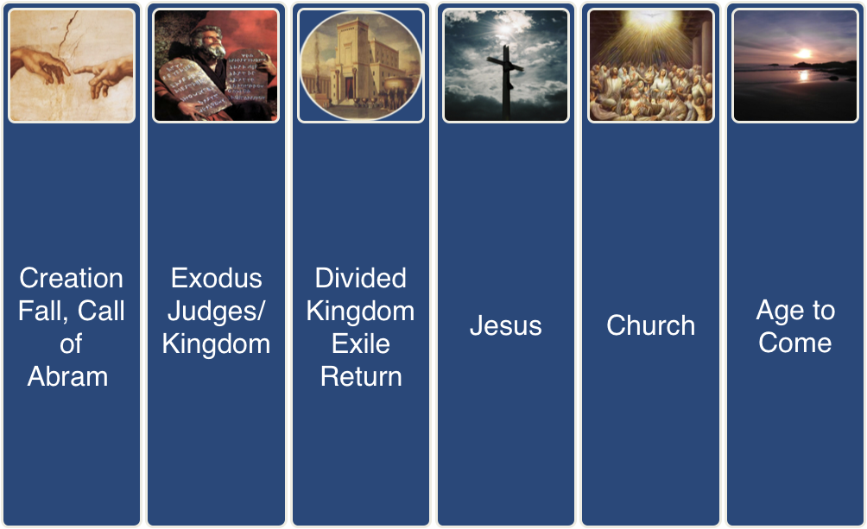
The Big Story
Only first word of slide title has initial capital letter (except proper nouns)
Don’t reduce this standard text size (28 point)
No punctuation usually needed in bullet points
No more than six points per slide
  For subsidiary points don’t go below this second level (24 point)

