Slide 1

Practical Theology
Hilton

Slide 2
The plan
We have a world of problems
We are born to solve problems
Practical theology: A model for problem solving

Slide 3
A world of problems
What is going on?

Slide 4
A world of problems
What is going on?
  There are multiple complex problems
Why is this going on?

Slide 5
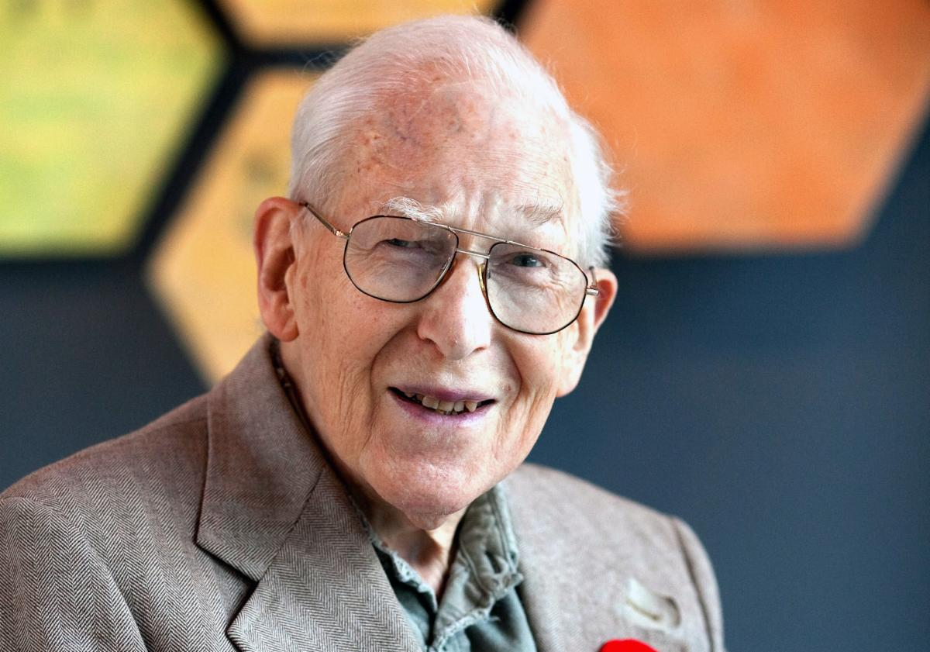
J.I. Packer
This depravity, or perversion of God’s image, is commonly, and rightly, said to be total: not in the sense that everything in man is as bad as it could be, but that nothing in man is as good as it should be.
  (18 Words)

Slide 6
A world of problems
What is going on?
  There are multiple complex problems
Why is this going on?
  Total depravity: sin taints every part of our world
What ought to be going on?

Slide 7
A world of problems
What is going on?
  There are multiple complex problems
Why is this going on?
  Total depravity: sin taints every part of our world
What ought to be going on?
  The world needs a saviour and renewal
What might we do?

Slide 8
A world of problems
What is going on?
  There are multiple complex problems
Why is this going on?
  Total depravity: sin taints every part of our world
What ought to be going on?
  The world needs a saviour and renewal
What might we do?

Slide 9
Questions: Our world ……….
A: Romans 8: 20-21 Our world is …….
B: Psalm 19:1-2 Our world is still ….
C: John 3:16 Our world is …..
D: John 3:17 Our world is not ………
E: 1 John 2:15 Worldly values and systems must be ………

Slide 10
Questions: Our world ……….
A: Romans 8: 20-21 Our world is damaged
B: Psalm 19:1-2 Our world is still good
C: John 3:16 Our world is loved
D: John 3:17 Our world is not condemned
E: 1 John 2:15 has values and systems that must be renounced

Slide 11
A world of problems
What is going on?
  Eve / the world has problems
Why is this going on?
  Total depravity: sin taints every part of our world
What ought to be going on?
  Eve needs help and a new heaven and earth
What might we do?

Slide 12
A world of problems
What is going on?
  There are multiple complex problems
Why is this going on?
  Total depravity: sin taints every part of our world
What ought to be going on?
  The world needs a saviour and renewal
What might we do?
  Practical theology

Slide 13
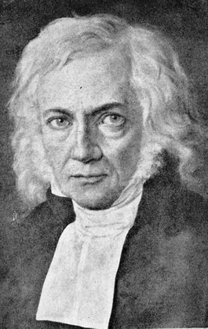
Friedrich Schleiermacher

Slide 14
Good Samaritan, Luke 10
On one occasion an expert in the law stood up to test Jesus. “Teacher,” he asked, “what must I do to inherit eternal life?”
²⁶ “What is written in the Law?” he replied. “How do you read it?”
²⁷ He answered, “‘Love the Lord your God with all your heart and with all your soul and with all your strength and with all your mind’^{[a]}; and, ‘Love your neighbour as yourself.’^{[b]}”
²⁸ “You have answered correctly,” Jesus replied. “Do this and you will live.”
²⁹ But he wanted to justify himself, so he asked Jesus, “And who is my neighbour?”

Slide 15
Good Samaritan, Luke 10
³⁰ In reply Jesus said: “A man was going down from Jerusalem to Jericho, when he was attacked by robbers. They stripped him of his clothes, beat him and went away, leaving him half dead. ³¹ A priest happened to be going down the same road, and when he saw the man, he passed by on the other side. ³² So too, a Levite, when he came to the place and saw him, passed by on the other side. ³³ But a Samaritan, as he travelled, came where the man was; and when he saw him, he took pity on him. ³⁴ He went to him and bandaged his wounds, pouring on oil and wine. Then he put the man on his own donkey, brought him to an inn and took care of him. ³⁵ The next day he took out two denarii^{[c]} and gave them to the innkeeper. ‘Look after him,’ he said, ‘and when I return, I will reimburse you for any extra expense you may have.’
³⁶ “Which of these three do you think was a neighbour to the man who fell into the hands of robbers?”
³⁷ The expert in the law replied, “The one who had mercy on him.”
Jesus told him, “Go and do likewise.”

Slide 16
Nicene Creed
We believe in one God,
the Father, the Almighty,
maker of heaven and earth,
of all that is,
seen and unseen.
We believe in one Lord, Jesus Christ,
the only Son of God,
eternally begotten of the Father,
God from God, Light from Light,
true God from true God,
begotten, not made,
of one Being with the Father;
through him all things were made.
For us and for our salvation he came down from heaven,
was incarnate from the Holy Spirit and the Virgin Mary and was made man.

Slide 17
Nicene Creed
For our sake he was crucified under Pontius Pilate;
he suffered death and was buried.
On the third day he rose again
in accordance with the Scriptures;
he ascended into heaven
and is seated at the right hand of the Father.
He will come again in glory to judge the living and the dead,
and his kingdom will have no end.
We believe in the Holy Spirit,
the Lord, the giver of life,
who proceeds from the Father and the Son,
who with the Father and the Son is worshipped and glorified,
who has spoken through the prophets.
We believe in one holy catholic and apostolic Church.
We acknowledge one baptism for the forgiveness of sins.
We look for the resurrection of the dead,
and the life of the world to come.
Amen.

Slide 18
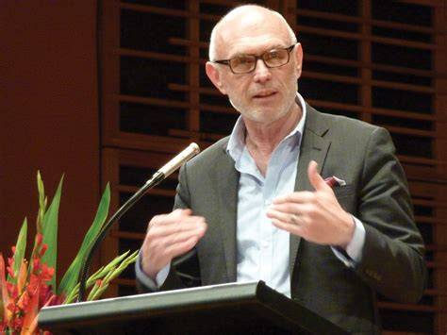
Miroslav Volf
Theology is not only about understanding the world;
it is about mending the world.

Slide 19
Matthew 25
³¹ “When the Son of Man comes in his glory, and all the angels with him, he will sit on his glorious throne. ³² All the nations will be gathered before him, and he will separate the people one from another as a shepherd separates the sheep from the goats. ³³ He will put the sheep on his right and the goats on his left.
³⁴ “Then the King will say to those on his right, ‘Come, you who are blessed by my Father; take your inheritance, the kingdom prepared for you since the creation of the world. ³⁵ For I was hungry and you gave me something to eat, I was thirsty and you gave me something to drink, I was a stranger and you invited me in, ³⁶ I needed clothes and you clothed me, I was sick and you looked after me, I was in prison and you came to visit me.’

Slide 20
Matthew 25
³⁷ “Then the righteous will answer him, ‘Lord, when did we see you hungry and feed you, or thirsty and give you something to drink? ³⁸ When did we see you a stranger and invite you in, or needing clothes and clothe you? ³⁹ When did we see you sick or in prison and go to visit you?’
⁴⁰ “The King will reply, ‘Truly I tell you, whatever you did for one of the least of these brothers and sisters of mine, you did for me.’

Slide 21
Questions:
What does John 17: 14-16 mean?
Do you think of yourself as a problem solver?
Matthew 25: 31-40 Why will we be judged on our practical assistance to the world?

Slide 22
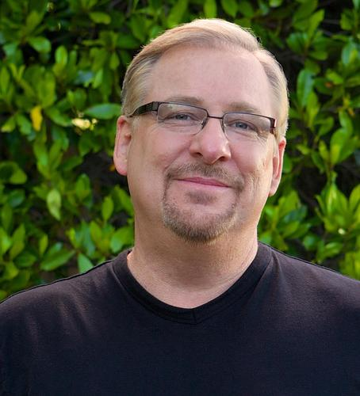
Rick Warren
You did not create yourself,
so you cannot tell yourself what you were created for!

Slide 23
Richard Osmer
What is going on?
  Listen carefully
Why is this going on?
  Use wisdom from every reliable source for understanding
What ought to be going on?
  Discern what God is saying
What might we do?
  Decide on practical action to solve the problem

Slide 24
Acts 6: 1-7
In those days when the number of disciples was increasing, the Hellenistic Jews^{[a]} among them complained against the Hebraic Jews because their widows were being overlooked in the daily distribution of food. ² So the Twelve gathered all the disciples together and said, “It would not be right for us to neglect the ministry of the word of God in order to wait on tables. ³ Brothers and sisters, choose seven men from among you who are known to be full of the Spirit and wisdom. We will turn this responsibility over to them ⁴ and will give our attention to prayer and the ministry of the word.”
⁵ This proposal pleased the whole group. They chose Stephen, a man full of faith and of the Holy Spirit; also Philip, Procorus, Nicanor, Timon, Parmenas, and Nicolas from Antioch, a convert to Judaism. ⁶ They presented these men to the apostles, who prayed and laid their hands on them.
⁷ So the word of God spread. The number of disciples in Jerusalem increased rapidly, and a large number of priests became obedient to the faith.

Slide 25
Richard Osmer
What is going on?
  Listen carefully
Why is this going on?
  Use wisdom from every possible source for understanding
What ought to be going on?
  Discern what a biblical solution should look like
What might we do?
  Decide on practical action to solve the problem

Slide 26
One more question:
When you grow up,
what problem in this world
would you like to solve?

