Slide 1

BT Online: Exile and Return
11th February 2025

Slide 2
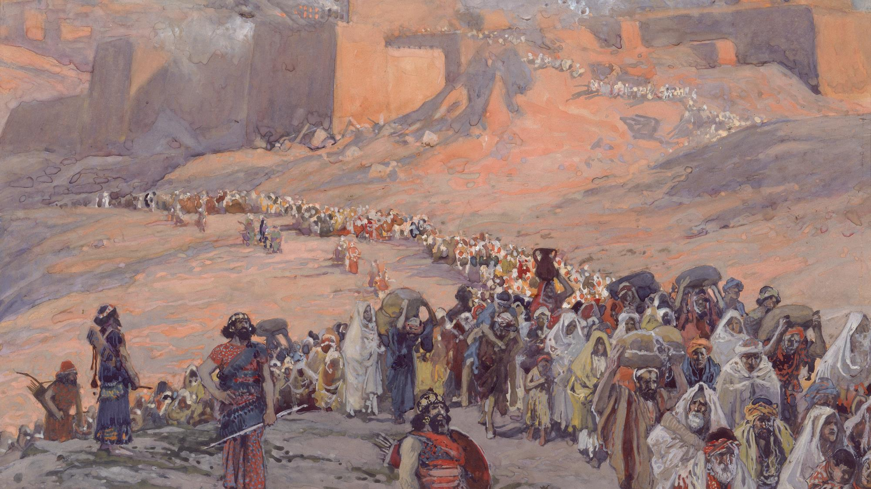
exile is the human condition, as we all long for a better home

Slide 3
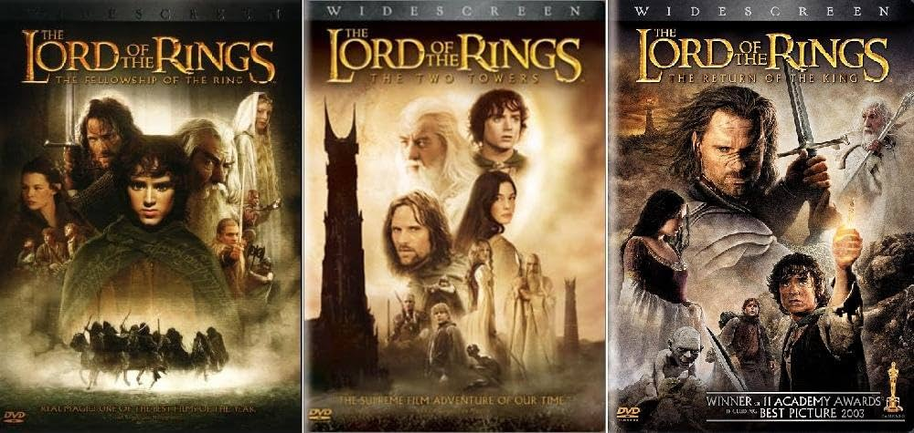
The Lord of the Rings

Slide 4
Tonight
Part 1 = the what and why of exile
Part 2 = the emotion and expectations of exile

Slide 5
Part One
‘To be in exile is to be disorientated, in the unknown, far from home’
Relationally
Politically
Theologically
Good → Sin → Exile

Slide 6


Slide 7

Jeremiah 1:1-3
“The words of Jeremiah son of Hilkiah, one of the priests at Anathoth in the territory of Benjamin. The word of the Lord came to him in the thirteenth year of the reign of Josiah son of Amon king of Judah, and through the reign of Jehoiakim son of Josiah king of Judah, down to the fifth month of the eleventh year of Zedekiah son of Josiah king of Judah, when the people of Jerusalem went into exile.”
605BC → 598/7BC → 587/6BC → 582BC

Slide 8

Succession
Text

Slide 9
Succession…
2 - Josiah
3 - Jehoahaz
4 - Jehoiakim
6 - Zedekiah
5 - Jehoiachin
1 - Amon

Slide 10

2 Kings 24:18-20 & Jeremiah 52:1-3
“Zedekiah was twenty-one years old when he became king, and he reigned in Jerusalem for eleven years. His mother’s name was Hamutal daughter of Jeremiah; she was from Libnah. He did evil in the eyes of the Lord, just as Jehoiakim had done. It was because of the Lord’s anger that all this happened to Jerusalem and Judah, and in the end he thrust them from his presence. Now Zedekiah rebelled against the king of Babylon.”

Slide 11
Deuteronomy 30:15-18
“See, I set before you today life and prosperity, death and destruction. For I command you today to love the Lord your God, to walk in obedience to him, and to keep his commands, decrees and laws; then you will live and increase, and the Lord your God will bless you in the land you are entering to possess. But if your heart turns away and you are not obedient, and if you are drawn away to bow down to other gods and worship them, I declare to you this day that you will certainly be destroyed. You will not live long in the land you are crossing the Jordan to enter and possess.”

Slide 12
A bigger picture
Jeremiah 9:11
“I will make Jerusalem a heap of ruins, a haunt of jackals; and I will lay waste the towns of Judah so no one can live there.”
1 Kings 8:27
“But will God really dwell on earth? The heavens, even the highest heaven, cannot contain you. How much less this temple I have built!”
John 2:19
“Jesus answered them, “Destroy this temple, and I will raise it again in three days.””

Slide 13
Thy will be done…
CS Lewis
“There are only two kinds of people in the end: those who say to God, ‘Thy will be done,’ and those to whom God says, in the end, ‘Thy will be done.’”
Good → Sin → Exile

Slide 14
2 Chronicles 36:11-16
“Zedekiah was twenty-one years old when he became king, and he reigned in Jerusalem for eleven years. He did evil in the eyes of the Lord his God and did not humble himself before Jeremiah the prophet, who spoke the word of the Lord. He also rebelled against King Nebuchadnezzar, who had made him take an oath in God’s name. He became stiff-necked and hardened his heart and would not turn to the Lord, the God of Israel. Furthermore, all the leaders of the priests and the people became more and more unfaithful, following all the detestable practices of the nations and defiling the temple of the Lord, which he had consecrated in Jerusalem. The Lord, the God of their ancestors, sent word to them through his messengers again and again, because he had pity on his people and on his dwelling-place. But they mocked God’s messengers, despised his words and scoffed at his prophets until the wrath of the Lord was aroused against his people and there was no remedy.”

Slide 15
Poll: what is your summation?
1: “Foolish Israelites! Serves them right … it should have happened sooner.”
2: “Poor Israelites! They didn’t know how bad it was … it feels a bit harsh.”
3: “Confused Israelites! It wasn’t their fault, wrong place at wrong time.”
4: “This is good for the Israelites! Exile is not a bad place to be.”
5: “Never mind the Israelites … this could describe my situation!”

Slide 16
Tonight
Part 1 = the what and why of exile
Part 2 = the emotion and expectation of exile

Slide 17
Exile…?
A lost opportunity? (Jeremiah 39-44)
The temporary end of history? (2 Kings)
Sabbath of the land? (2 Chronicles – Ezra)

Slide 18
Sadness & Lament(ations)
Lamentations 1:1
“How deserted lies the city, once so full of people! How like a widow is she, who once was great among the nations! She who was queen among the provinces has now become a slave.”
Lamentation 3:1 “I am the man who has seen affliction by the rod of the Lord’s wrath.”
Lamentations 3:22 “Because of the Lord’s great love we are not consumed, for his compassions never fail.”

Slide 19
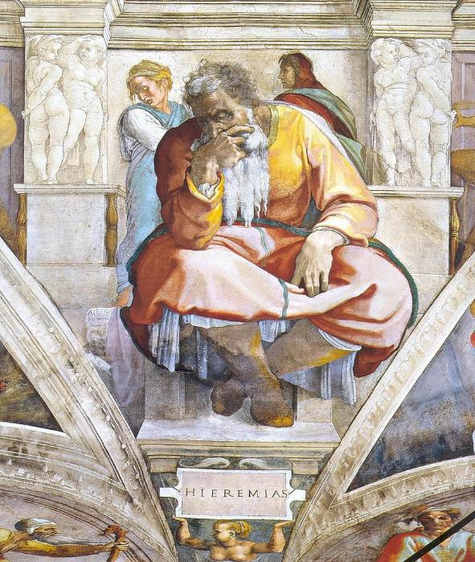
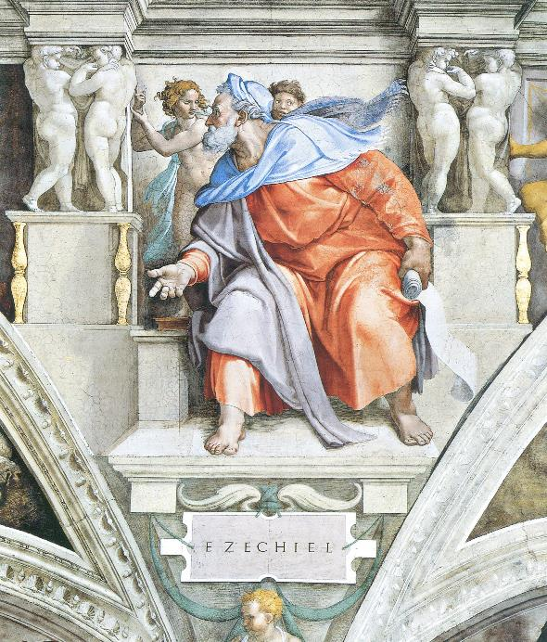
Hope & Prophecy

Slide 20
Psalm 137
By the rivers of Babylon we sat and wept when we remembered Zion.
There on the poplars we hung our harps,
for there our captors asked us for songs, our tormentors demanded songs of joy;
they said, ‘Sing us one of the songs of Zion!’
How can we sing the songs of the Lord while in a foreign land?
If I forget you, Jerusalem, may my right hand forget its skill.
May my tongue cling to the roof of my mouth if I do not remember you,
if I do not consider Jerusalem my highest joy.
Remember, Lord, what the Edomites did on the day Jerusalem fell.
‘Tear it down,’ they cried,
‘tear it down to its foundations!’
Daughter Babylon, doomed to destruction, happy is the one who repays you according to what you have done to us.
Happy is the one who seizes your infants and dashes them against the rocks.

Slide 21
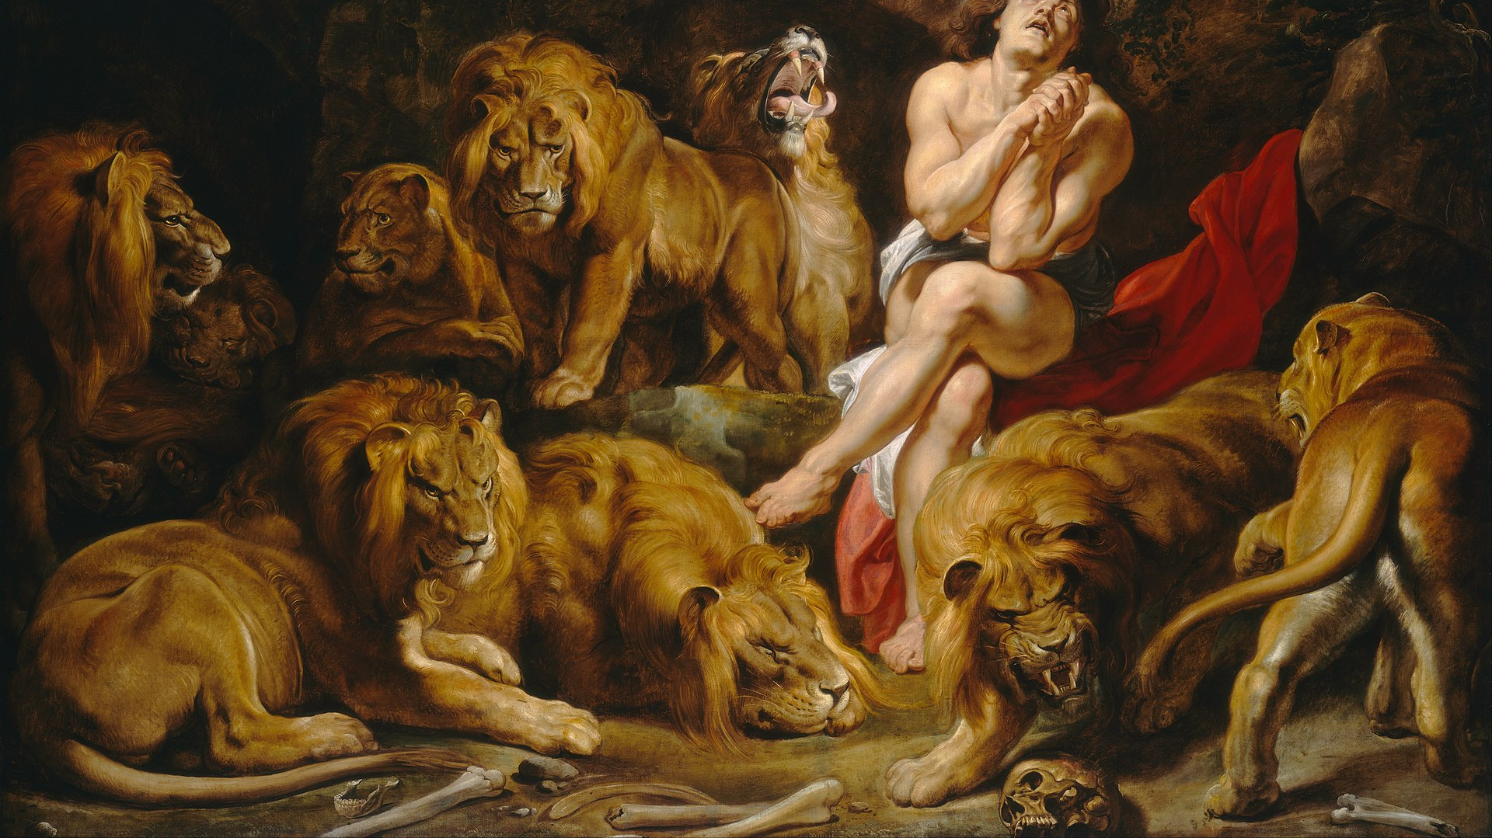
Daniel

Slide 22
Daniel 9:1-3
“In the first year of Darius son of Xerxes (a Mede by descent), who was made ruler over the Babylonian kingdom – in the first year of his reign, I, Daniel, understood from the Scriptures, according to the word of the Lord given to Jeremiah the prophet, that the desolation of Jerusalem would last seventy years. So I turned to the Lord God and pleaded with him in prayer and petition, in fasting, and in sackcloth and ashes.”

Slide 23
The story of return
Land
Temple
Kingship
Glory

Slide 24
Nehemiah 1:2-3
“Hanani, one of my brothers, came from Judah with some other men, and I questioned them about the Jewish remnant that had survived the exile, and also about Jerusalem. They said to me, ‘Those who survived the exile and are back in the province are in great trouble and disgrace. The wall of Jerusalem is broken down, and its gates have been burned with fire.’”

Slide 25
Exilic Expectations
Disillusionment … does God love me?
Legalism … God owes me!
Expectation … don’t let me down God!

Slide 26
Fundamental Realities
God hates sin and will judge it (Exodus 34:7)
God is merciful and forgiving (Exodus 34:6-7)

Slide 27
Matthew 1:17
“Thus there were fourteen generations in all from Abraham to David, fourteen from David to the exile to Babylon, and fourteen from the exile to the Messiah.”

